Slide 1
Unit 1.
NumPy Array Data Structure for Optimal Computational Performance
1.1. NumPy Arrays
1.2. NumPy Array Basics
1.3. NumPy Array Operations
1.4. NumPy Indexing and Slicing
1.5. Array Transposition and Axis Swap

Slide 2
1.1. NumPy Arrays
UNIT 01
What is NumPy?
NumPy stands for Numerical Python, which is a basic package for Data Science.
It is a Python Library that provides multidimensional array objects, various derived objects (matrices, etc.), and an assortment of routines for fast operation on arrays.
It supports discrete Fourier transforms, basic linear algebra, basic statistical operations, random simulations, etc.
The ndarray object is the core of the NumPy package. It processes n-dimensional arrays of homogenous data types.

Slide 3
Unit 1.
NumPy Array Data Structure for Optimal Computational Performance
1.1. NumPy Arrays
1.2. NumPy Array Basics
1.3. NumPy Array Operations
1.4. NumPy Indexing and Slicing
1.5. Array Transposition and Axis Swap

Slide 4
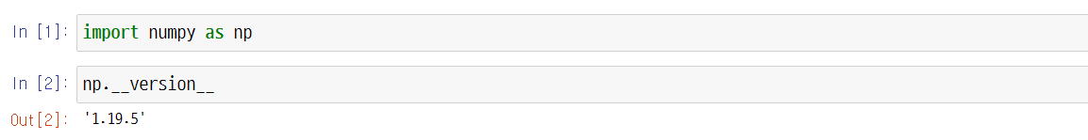

1.2. NumPy Array Basics
UNIT 01
How to Import NumPy
NumPy Library Import
For better readability of the code, abbreviate NumPy to np. This is a rule adopted by all those working with codes so that it can be easily understood.
In Python, objects generally have properties and methods. The property is another Python object stored inside the object, and the method refers to a function that allows access to the internal data of the object. It can be approached in the form of np.attrribute_name.
Line 1
As stands for alias, meaning it is abbreviated.
Line 2
To view the version of NumPy, use the built-in property ____version__.

Slide 5
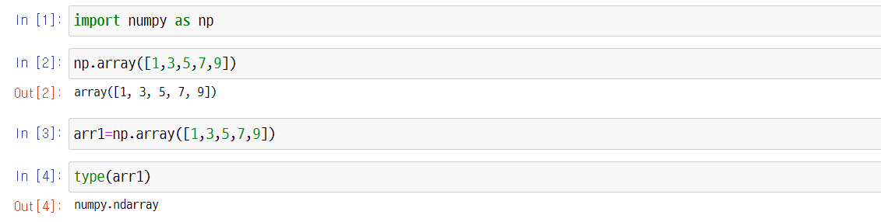
1.2. NumPy Array Basics
UNIT 01
NumPy Array Basics
NumPy ndarray
An n-dimensional array object is called a ndarry. It can be used to process and store large datasets.
Fast and flexible arrangements use a similar grammar used for operations between scalar elements. They use mathematical operations for the entire data block.
First, an arrangement may be made into a sequence (list, tuple, array, set).
Notes:
NumPy arrays can be created in many different ways.
Be careful to avoid simple assignments. You are not creating a new object.
Instead, you are creating a different name for the same object.

Slide 6
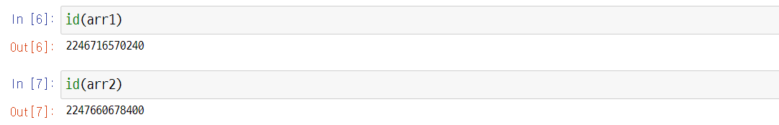
1.2. NumPy Array Basics
UNIT 01
Here is one more arrangement.
Check the address of each array using a function representing the address id.

Slide 7
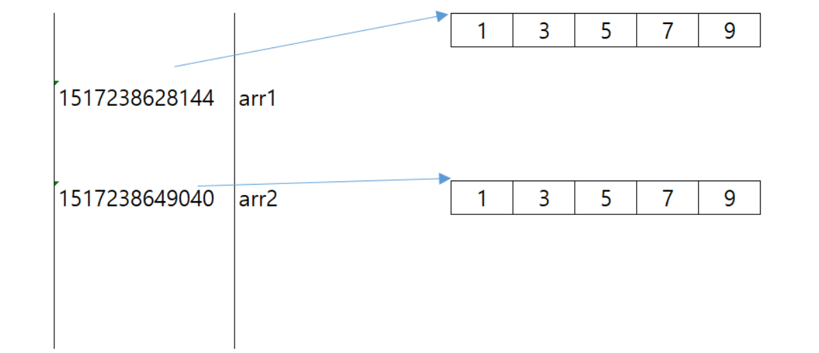
1.2. NumPy Array Basics
UNIT 01
The actual value inside is the same, but the address is confirmed to be different because it is its own object.
1
3
5
7
9
2246716570240
arr1
2247660678400
arr2
1
3
5
7
9
In Python, the = symbol is an assignment operator that assigns address values.
Notes:
Help students don’t be confused because they see different address on their computer monitor.
Each computer has its unique address. So students will see the different address in their computer screen.

Slide 8
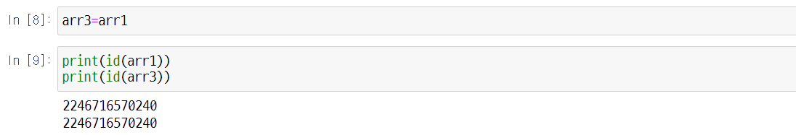
1.2. NumPy Array Basics
UNIT 01
Let’s assign the address arr1 to the variable arr3.
Line 9
After assigning the address values, we can see that the address values are the same.

Slide 9
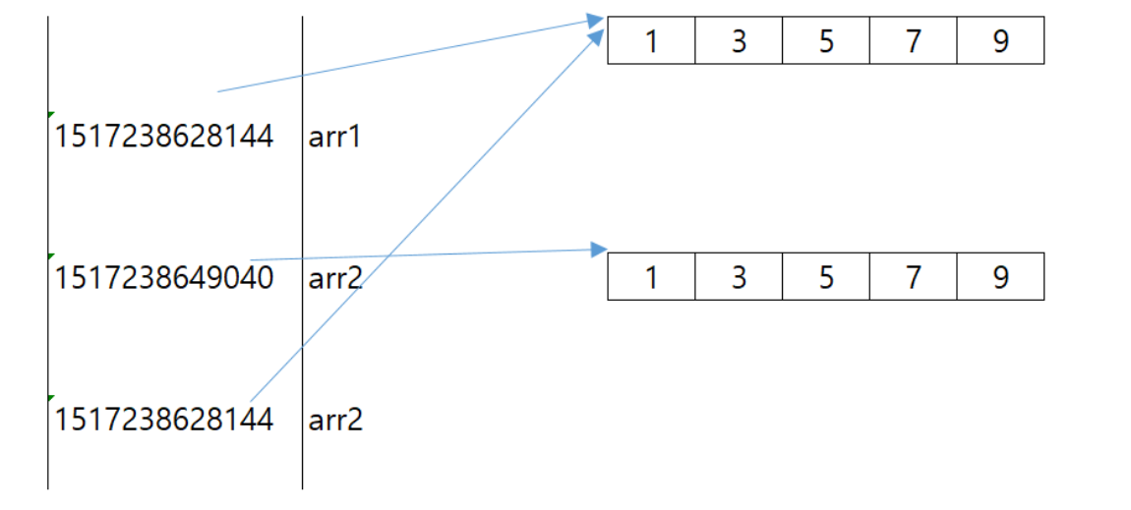
1.2. NumPy Array Basics
UNIT 01
We can see that the address values are the same.
1
3
5
7
9
2246716570240
arr1
2247660678400
arr2
1
3
5
7
9
2246716570240
arr3
arr3

Slide 10
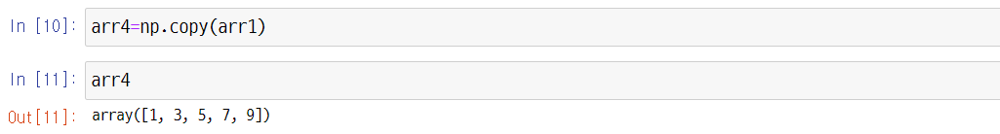
1.2. NumPy Array Basics
UNIT 01
If you want to copy only the value, you can use np.copy(). See help(np.copy) for more detail.
Then let’s check the address value.
Line 12
Since only the value was copied, you can see that the address value is different.

Slide 11
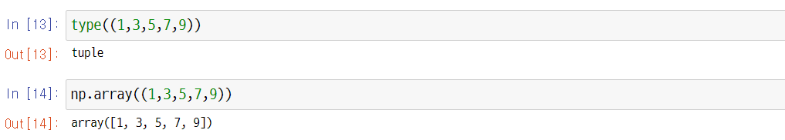
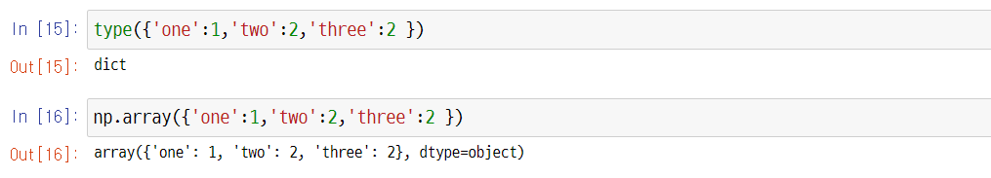
1.2. NumPy Array Basics
UNIT 01
Creating Arrays with Tuples
Creating Arrays with Dictionaries

Slide 12
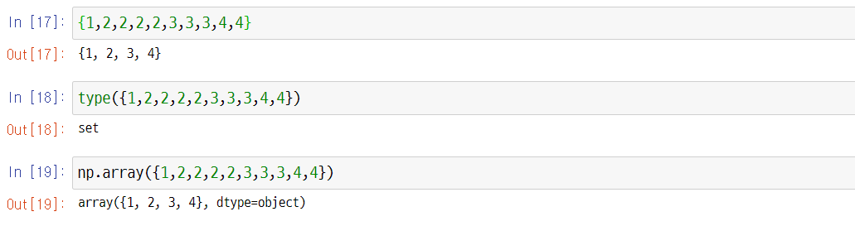
1.2. NumPy Array Basics
UNIT 01
Creating Arrays with Sets
Normally, lists are commonly used to create arrays.

Slide 13
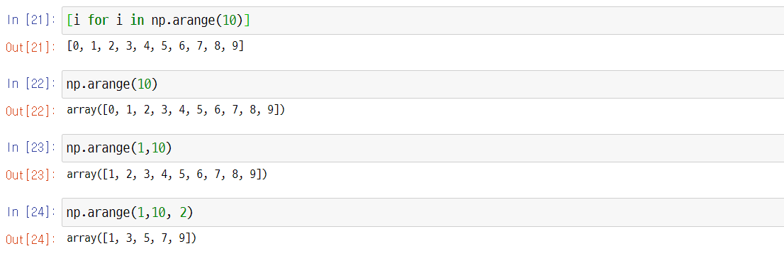
1.2. NumPy Array Basics
UNIT 01
Creating Arrays with arange
This is the same concept as the range in standard Python.
For NumPy arrays, use np.arrange.

Slide 14
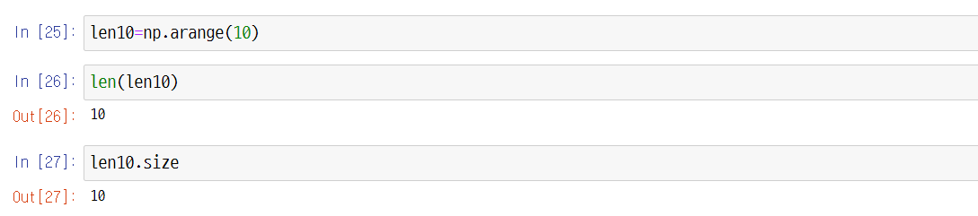
1.2. NumPy Array Basics
UNIT 01
Use the len() method and the size property for the size of the array.

Slide 15
1.2. NumPy Array Basics
UNIT 01
The NumPy array deals with each element by converting it to the same data type. (1/3)
The important thing is that the NumPy arrays process the same type quickly and effectively, as one of its characteristics.
However, although arrays can be made with different types of arrays, each type is converted into the same type.
Line 28
Different types of arrays can be created, such as integers, floats, and Booleans.

Slide 16
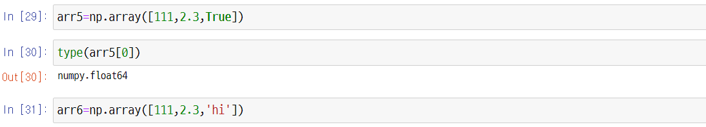
1.2. NumPy Array Basics
UNIT 01
The NumPy array deals with each element by converting it to the same data type. (2/3)
Due to the . in the integer type, the array is converted into a float when integer, float, and Boolean types are together.
Line 30
The data type of NumPy is returned in NumPy.datatype format.
Line 31
Different types of arrays are created, such as integers, floats, and strings.

Slide 17
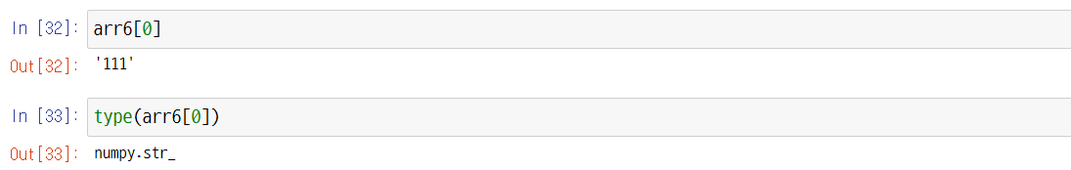
1.2. NumPy Array Basics
UNIT 01
The NumPy array deals with each element by converting it to the same data type. (3/3)
Line 33
Due to the '111’ in the integer type, the array is converted into a string when integer, float, and string types are together.

Slide 18
1.2. NumPy Array Basics
UNIT 01
The Data Types of NumPy Arrays are as follows:
Data Type | Explanation
int8, int16, int32, int64, int_ uint8, uint16, uint32, uint64 | Integer
float16, float32, float64, float128, float_ | Floating point
bool_ | Boolean
string_, unicode_ | String
The 8 in int8 is 8 bitss, which is the range of values that this value can represent.
https://docs.scipy.org/doc/NumPy-1.17.0/reference/arrays.dtypes.html

Slide 19
1.2. NumPy Array Basics
UNIT 01
Explanation of 8 bits
Since the bit represents two values, 8 bits can become 2 to the power of 8, representing up to 256 integers. In integers, this value ranges from -128 to 127. The range is up to 127, and not 128, because zero is excluded.
If only positive values are used, the space in the range of negative numbers needs to be crossed over to positive numbers. At this time, u, the first letter of the unsigned (meaning positive), is used.
Therefore, uint8 ranges from 0 to 255.

Slide 20
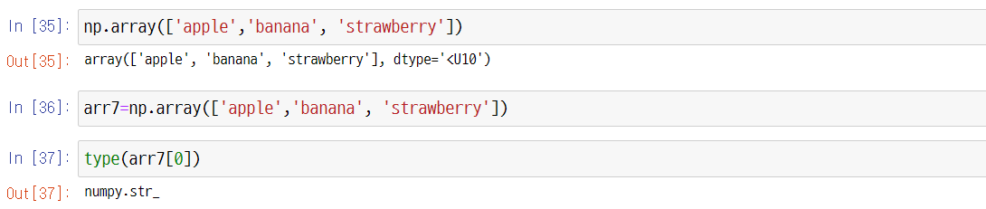
1.2. NumPy Array Basics
UNIT 01
Data Types of NumPy Arrays
Line 35
The U10, here, represents Unicode, and the < symbol represents 10byte or less.

Slide 21
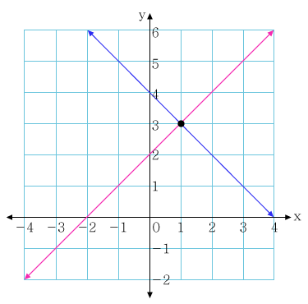
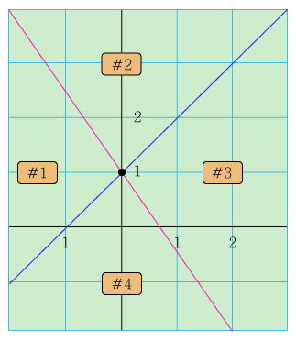
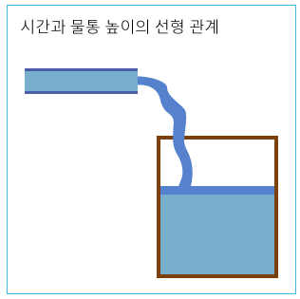
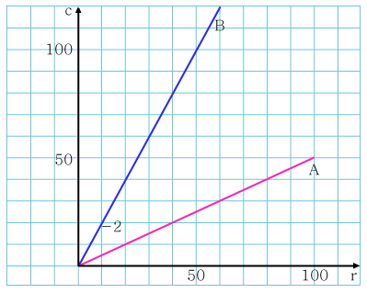
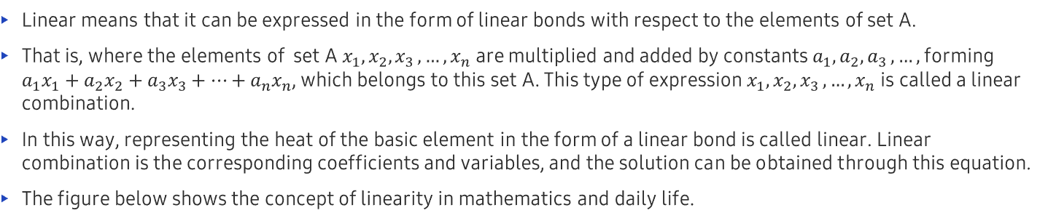
1.2. NumPy Array Basics
UNIT 01
Creating Arrays with the linspace Function (1/2) – See help(np.linspace) for more detail.
Linear means that it can be expressed in the form of linear bonds with respect to the elements of set A.
That is, where the elements of set A $x_{1},x_{2}{,x}_{3},…,x_{n}$ are multiplied and added by constants $a_{1},a_{2}{,a}_{3},…,$ forming $a_{1}x_{1}+a_{2}x_{2}+a_{3}x_{3}+…+a_{n}x_{n}$, which belongs to this set A. This type of expression $x_{1},x_{2}{,x}_{3},…,x_{n}$ is called a linear combination.
In this way, representing the heat of the basic element in the form of a linear bond is called linear. Linear combination is the corresponding coefficients and variables, and the solution can be obtained through this equation.
The figure below shows the concept of linearity in mathematics and daily life.
Linear relationship between time and the height of the water bottle

Slide 22
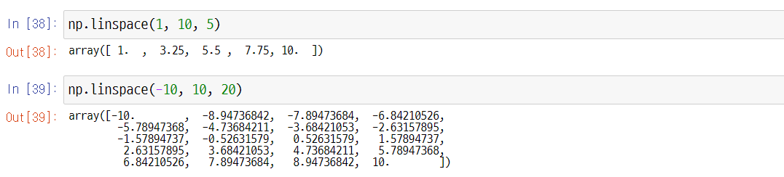
1.2. NumPy Array Basics
UNIT 01
Creating Arrays with the linspace Function (2/2)
Line 38
Five numbers in the linear space from 1 to 10.
Line 39
20 numbers in the linear space from 10 to 10.

Slide 23
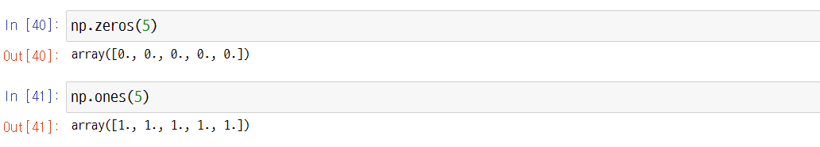
1.2. NumPy Array Basics
UNIT 01
Creating Arrays with np.zeros() and np.ones()
Line 40
Be careful not to skip the “s.”

Slide 24
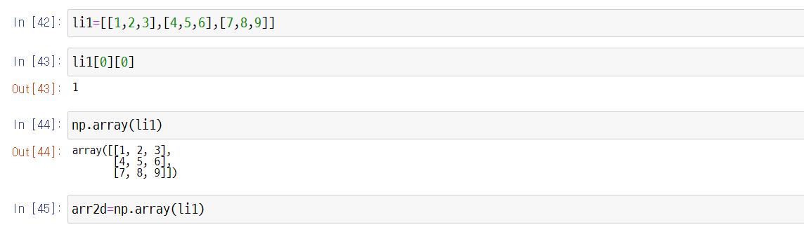
1.2. NumPy Array Basics
UNIT 01
Multidimensional Arrays
A multidimensional array refers to an array of two or more dimensions. It can be made in the form of a list in the list.
Line 43
The first element in this list is also a list, so the first element in that list is 1.
Line 44
Two-dimensional Array

Slide 25
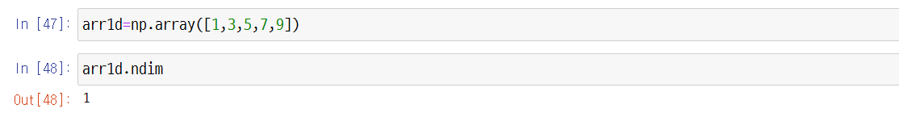
1.2. NumPy Array Basics
UNIT 01
Check the dimensions of the array with ndim.
Then, let’s check the one-dimensional array that we learned before.

Slide 26
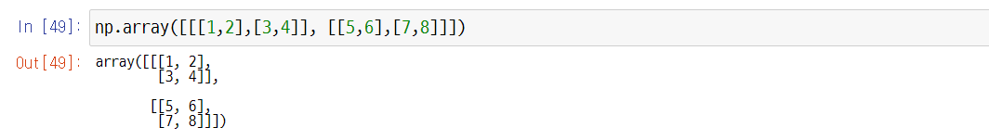
1.2. NumPy Array Basics
UNIT 01
We will also make a three-dimensional array.
5
6
1
7
8
2
3
4

Slide 27
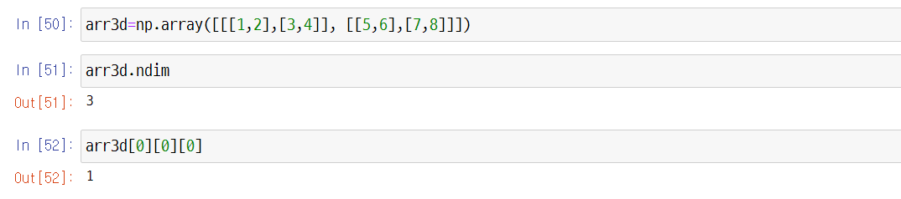
1.2. NumPy Array Basics
UNIT 01
Three-Dimensional Array
Line 50
A surface is two-dimensional and can be stacked. It’s easy to understand if you think of the surface as a piece of paper.
Line 52
When extracting a three-dimensional value, it’s easier to think of it as a method of approaching step by step.

Slide 28
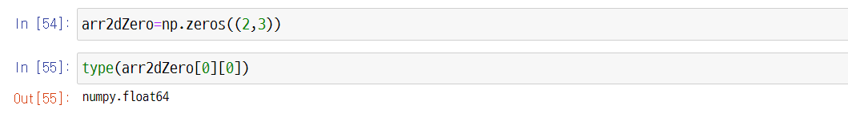
1.2. NumPy Array Basics
UNIT 01
Creating two-dimensional shapes using np.zeros()
Line 53
Designate it as two rows and three columns in the form of a tuple.
When created, the element within it is normally a float.

Slide 29
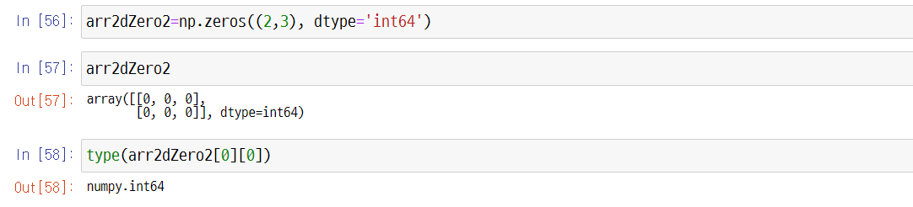
1.2. NumPy Array Basics
UNIT 01
If it is created by a different type, designate the parameter name using dtype.

Slide 30
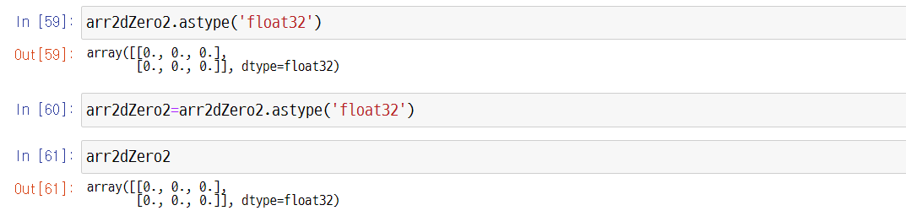
1.2. NumPy Array Basics
UNIT 01
Use the astype() method if you want to change the type to a float.

Slide 31
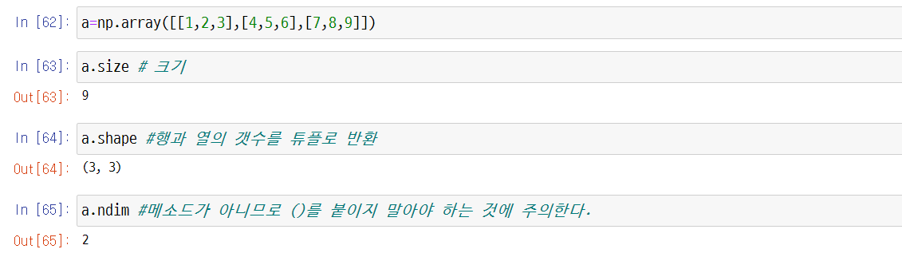
1.2. NumPy Array Basics
UNIT 01
Properties of the NumPy Array
Explanation of Each Property
Note that since it is not a method, () should not be attached.
Line 63
Size
Line 64
Converting the row and columns into a tuple

Slide 32
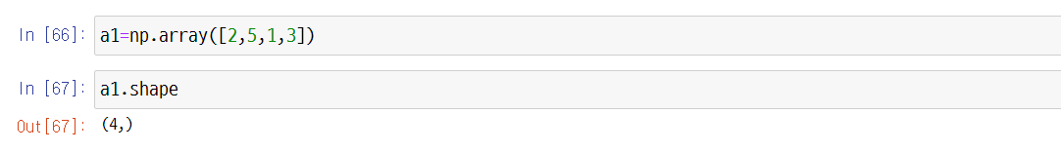
1.2. NumPy Array Basics
UNIT 01
It should be noted that for one-dimensional arrays, the tuples return the number of elements.

Slide 33
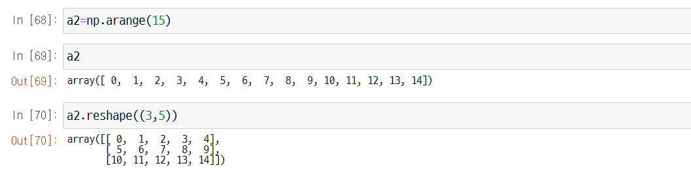
1.2. NumPy Array Basics
UNIT 01
Reshape
How to Reshape
Line 70
Be sure to input the shape as a tuple.

Slide 34
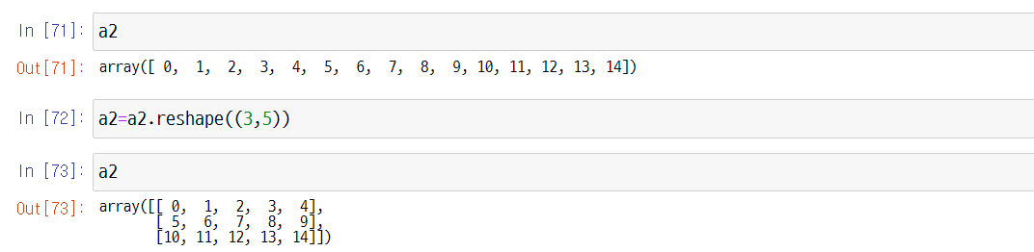
1.2. NumPy Array Basics
UNIT 01
Checking the shape of the object
Line 71
When checked, the shape of the object remains the same. Thus, it should be assigned again to create a new object.

Slide 35
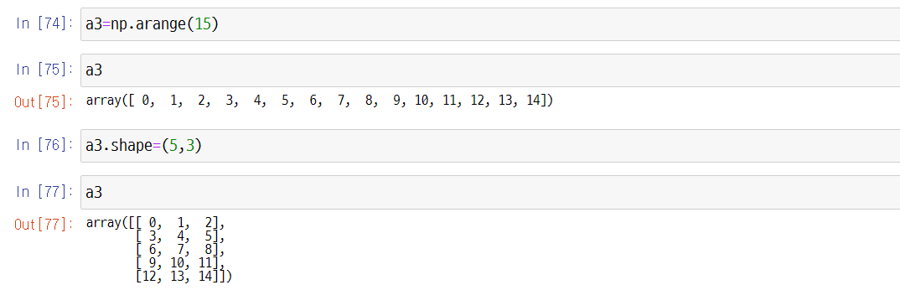
1.2. NumPy Array Basics
UNIT 01
The shape can be changed directly.

Slide 36
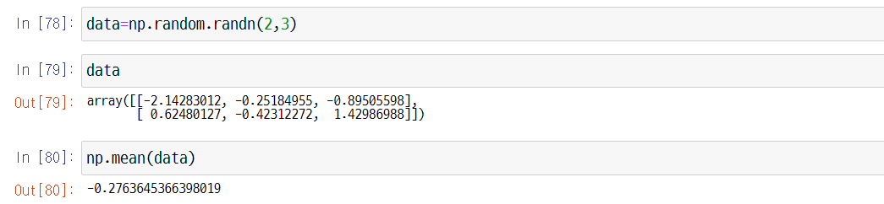
1.2. NumPy Array Basics
UNIT 01
Random Numbers
Data following the standard normal distribution (average 0, standard deviation 1) is generated as random numbers. See help(np.random.randn) for more detail.
Line 78
The generated data follows the standard normal distribution with shapes in two rows and three columns.
Notes:
A special case of the Normal probability density is that of the Standard Normal probability density.
In this case, you have $μ=0$ and $σ=1$.
Normal distribution will be explained in detail in Unit 2 of Chapter 4

Slide 37
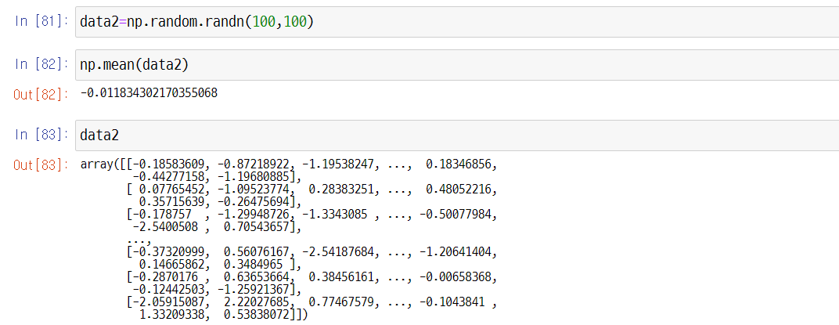
1.2. NumPy Array Basics
UNIT 01
Creating data2 with 100 rows and 100 columns

Slide 38
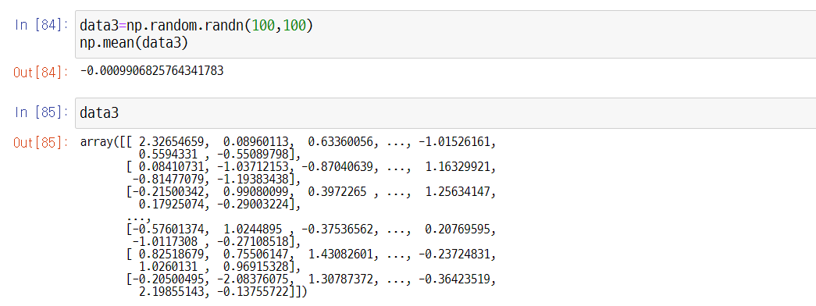
1.2. NumPy Array Basics
UNIT 01
Go ahead and create data3 as well.
The average is close to zero but not completely zero. If more data is generated, then the results get closer to zero.

Slide 39
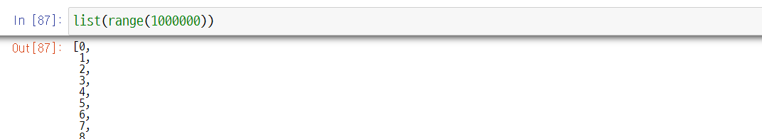
1.2. NumPy Array Basics
UNIT 01
Comparing Python Lists vs. NumPy Arrays: Processing Speed (1/4)
Let’s compare a Python list and a NumPy array that stores a million integers.
If you run the example below, you can see that the code using NumPy is much faster than the code written with pure Python.
By approaching np objects, denoted by abbreviating NumPy, you can create 1 million arrays starting from 0 using the arange method.
Here is a data structure of the list for comparison's sake.

Slide 40
1.2. NumPy Array Basics
UNIT 01
Comparing Python Lists vs. NumPy Arrays: Processing Speed (2/4)
Line 88
It returns the result in the form of NumPy.ndarray. This means that there is an array with n-dimensions.

Slide 41
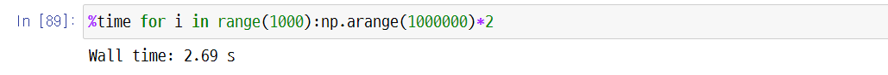
1.2. NumPy Array Basics
UNIT 01
Comparing Python Lists vs. NumPy Arrays: Processing Speed (3/4)
The following shows the speed of the Python array and the operation of multiplying each value of 1 million lists by 2, 1000 times.
%time is an IPython magic command that returns a single execution time. This magic command is a special command designed to easily control general tasks and other operations in the IPython system.
Magic commands are labeled with a % sign.
It took 46.5 seconds. There is a difference of more than 20 times.
Once again, it is important to understand the pros and cons of the arrays and lists we learned earlier to perform large-scale Big Data AI operations in the future. This would be a clear reason why we must learn and use NumPy when operating with such operations.

Slide 42
1.2. NumPy Array Basics
UNIT 01
Comparing Python Lists vs. NumPy Arrays: Processing Speed (4/4)
The results may differ in each user’s system, as we just saw on the screen.
Wall time, also called Wall-clock time, is the sum of the entire time it takes for the program to run and end, including CPU, I/O, Sub Program, etc.
To summarize vectorization once more, vectorization is one of the biggest reasons for using NumPy.
Vectorization is the operation of placing data without using loops or indexing.
NumPy’s vectorization optimizes the placement operation with compiled C code by performing it out of sight. For example, the loop statement code for calculating the weight of machine learning uses NumPy vectorization.

Slide 43
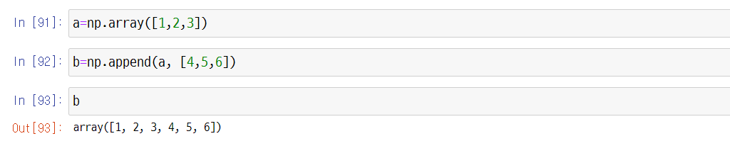
1.2. NumPy Array Basics
UNIT 01
Adding Elements to NumPy Arrays
A value is added to the one-dimensional data. The rank of the first-dimension is 1. See help.(np.append) for more detail.

Slide 44
1.2. NumPy Array Basics
UNIT 01
NumPy.append() method (1/3)
You can extend a NumPy array by calling the NumPy.append() method. Note that, unlike the lists, the plus ‘+’ operator cannot be used for this purpose.
When an array has orientations, you can specify the directions. For a 2D array, the axis argument set to 0 means vertical extension, while 1 means horizontal extension.
NumPy.append() provides just a view. For the changes to remain, the result should be assigned to a variable.

Slide 45
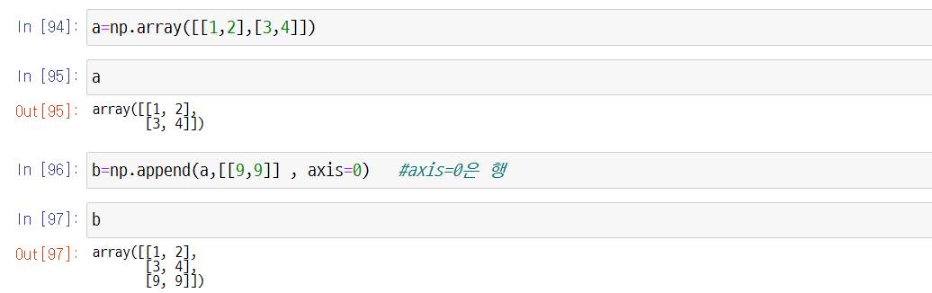
1.2. NumPy Array Basics
UNIT 01
NumPy.append() method (2/3)
Line 96
axis=0 is a row.

Slide 46
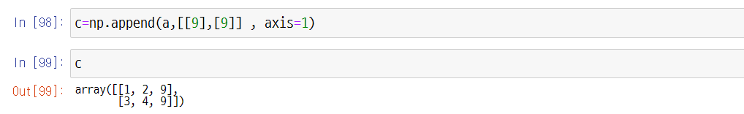
1.2. NumPy Array Basics
UNIT 01
NumPy.append() method (3/3)
Line 98
axis=1 is a column.

Slide 47
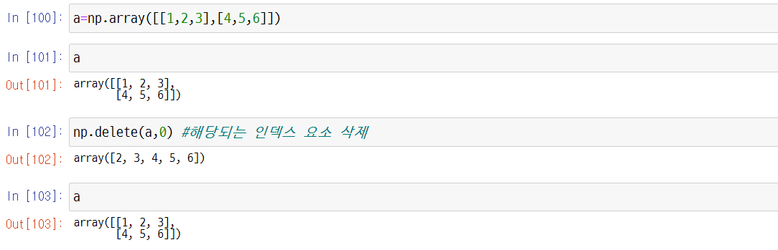
1.2. NumPy Array Basics
UNIT 01
Deleting Elements from NumPy Arrays
Method of Deleting Elements from Arrays (1/2)
Line 102
Delete the corresponding index element.
Line 103
Although the element was deleted, the array remains the same because no assignment was made.

Slide 48
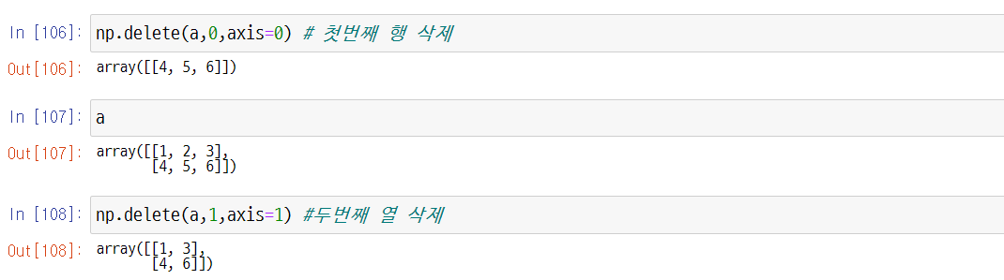
1.2. NumPy Array Basics
UNIT 01
Method of Deleting Elements from Arrays (2/2)
Line 106
Delete the first row.
Line 108
Delete the second column.

Slide 49
Unit 1.
NumPy Array Data Structure for Optimal Computational Performance
1.1. NumPy Arrays
1.2. NumPy Array Basics
1.3. NumPy Array Operations
1.4. NumPy Indexing and Slicing
1.5. Array Transposition and Axis Swap

Slide 50
1.3. NumPy Array Operations
UNIT 01
Basic Operations
We learned earlier that the unique feature of the NumPy array operation is that data can be processed collectively without using a for loop statement, which is called vectorization. In this case, arithmetic operations between arrays of the same size are applied in each element unit of the array.
For this reason, popular machine learning and deep learning libraries, such as scikit-learn, TensorFlow, PyTorch, etc., were all made based on NumPy.
This is a summary of the characteristics of NumPy that we’ve learned so far.
A low-level, high-performance library implemented in C
Supports fast, memory-effective multidimensional array ndarray operations
Supports various computational functions such as linear algebra, random number generator, Fourier transform, etc.

Slide 51
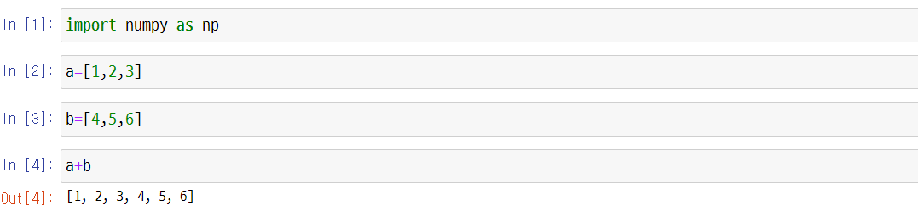
1.3. NumPy Array Operations
UNIT 01
Comparing Python Lists and NumPy Arrays: + Operator
Line 4
In a list, the + operator means connecting the given elements.

Slide 52
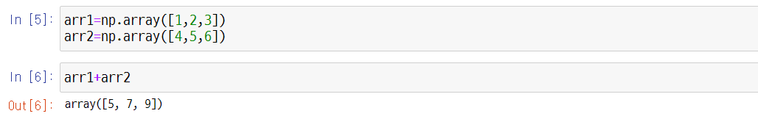
1.3. NumPy Array Operations
UNIT 01
Comparing Python Lists and NumPy Arrays: + Operator
Line 6
In a NumPy array, each element is calculated.

Slide 53
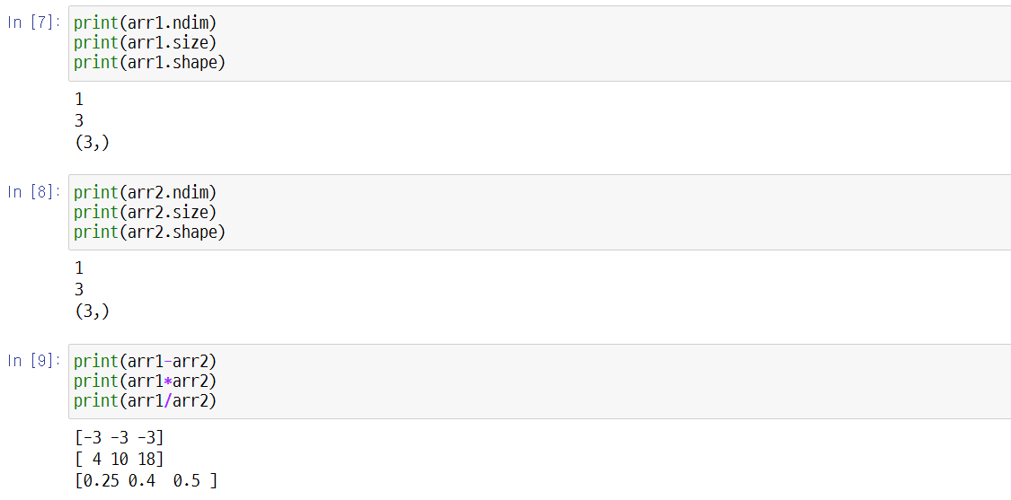
1.3. NumPy Array Operations
UNIT 01
If the shape of the array is the same, you can perform addition, subtraction, multiplication, and division operations.

Slide 54
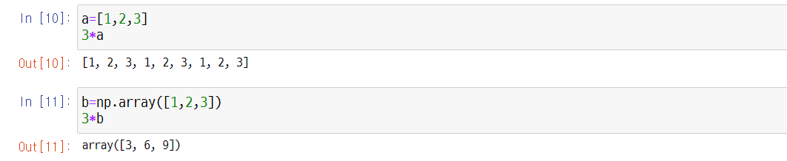
1.3. NumPy Array Operations
UNIT 01
Comparing Python Lists and NumPy Arrays: Multiplication
Line 10
In a list, the * operator means repetition.
Line 11
Multiplication in a NumPy array returns the multiplication result of each element.

Slide 55
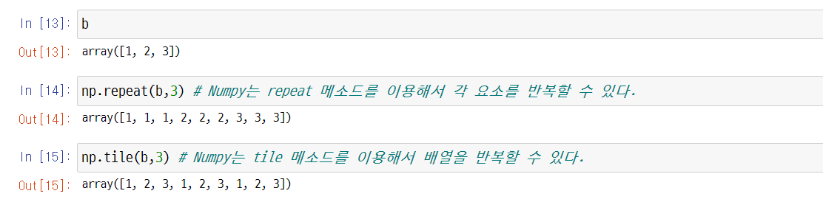
1.3. NumPy Array Operations
UNIT 01
repeat & tile
Line 14
In NumPy, the repeat method is used to repeat each element.
Line 15
In NumPy, the tile method is used for repeating the array.

Slide 56
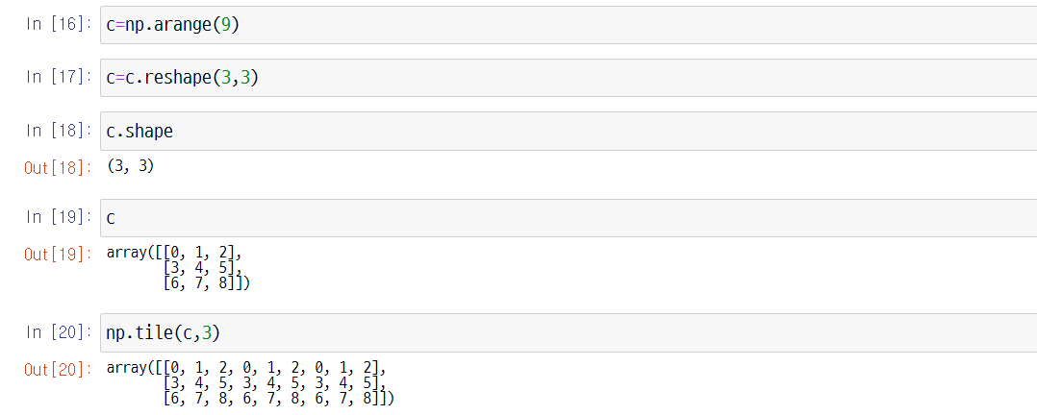
1.3. NumPy Array Operations
UNIT 01
When using the tile method, the array can be repeated into a two-dimensional form.

Slide 57

1.3. NumPy Array Operations
UNIT 01
Arrays can also perform exponential operations.

Slide 58

1.3. NumPy Array Operations
UNIT 01
The array can also perform comparison operations. After checking whether each element matches the conditions, it returns True if there is a match and False if otherwise.

Slide 59

1.3. NumPy Array Operations
UNIT 01
Universal Functions (1/3)
Universal functions operate element by element on whole arrays. See help(np.ufunc) for more detail.
1.3. NumPy Array Operations

Slide 60
1.3. NumPy Array Operations
UNIT 01
Universal Functions (2/3)
NumPy functions:
Function | Explanation | Universal function?
sin, cos, tan | Trigonometric functions | Yes
arcsin, arccos, arctan | Inverse trigonometric functions | Yes
round | Round to a given number of decimals | Yes
floor | Returns the nearest smaller integer | Yes
ceil | Returns the nearest greater integer | Yes
fix | Returns the nearest integer closer to 0 | Yes
prod | Returns the product of the array elements | No
cumsum | Returns the cumulative sums of an array | No
sum, mean, var, std, median | Statistical functions | No
exp, log | Exponential and logarithmic functions | Yes
unique | Returns the unique values of an array | No
min, max, argmax, argmin | Minimum, maximum, and the corresponding indices | No
https://docs.scipy.org/doc/NumPy-1.17.0/reference/

Slide 61
1.3. NumPy Array Operations
UNIT 01
Universal Functions (3/3)
Statistical methods of NumPy arrays:
Method | Explanation
mean | Average
var | Variance
std | Standard deviation
sum | Total sum
cumsum | The cumulative sums of an array
max, min | The maximum and the minimum of an array
argmax, argmin | Indices of the maximum and the minimum
https://docs.scipy.org/doc/NumPy-1.17.0/reference/

Slide 62

1.3. NumPy Array Operations
UNIT 01
Statistical methods of NumPy arrays:
Line 33
Sum
Line 34
Average

Slide 63

1.3. NumPy Array Operations
UNIT 01
Statistical methods of NumPy arrays:
Line 35
Average 5.5
Line 36
Deviation (difference from average)
Line 37
Square of Deviation

Slide 64

1.3. NumPy Array Operations
UNIT 01
Statistical methods of NumPy arrays:
Line 39
Sum of Squared Deviation

Slide 65

1.3. NumPy Array Operations
UNIT 01
Statistical methods of NumPy arrays:
Line 40
The sum of the squared deviations divided by the number of arrays is called a variance.
This result can be calculated directly through the process above, or the var() can be used.
Line 42
The square root of the variance is the standard deviation.

Slide 66
1.3. NumPy Array Operations
UNIT 01
Statistical methods of NumPy arrays:
Line 40
The sum of the squared deviations divided by the number of arrays is called a variance.
This result can be calculated directly through the process above, or the std() method can be used.

Slide 67
1.3. NumPy Array Operations
UNIT 01
Statistical methods of NumPy arrays:
Line 44
The cumsum() method is used to find the cumulative sum of x.

Slide 68

1.3. NumPy Array Operations
UNIT 01
Statistical methods of NumPy arrays:
Line 47
In this way, you can designate it as two rows and three columns. However, if you designate only a row, use -1 to change the rest on its own.

Slide 69

1.3. NumPy Array Operations
UNIT 01
Statistical methods of NumPy arrays:
Statistical functions can also be used for each row and column.
Line 52
The average of 1 and 4 is 2.5. When the axis = 0, the operation is carried out along the columns.
Line 53
The average of 1, 2, and 3 is 2. When the axis = 1, the operation is carried out along the rows.

Slide 70
1.3. NumPy Array Operations
UNIT 01
About Random Numbers in NumPy
Line 54
Initializing the seed value using np.ramdom will generate a fixed random number when generating random number values.
Notes:
Setting np.random.seed() to a fixed value generates uniform random numbers.
Run the codes below. You can see that the same seed generates the same set of numbers and using a different seed produces different set of numbers.
When setting the seed to a same value, same random numbers are generated in order.
np.random.seed(0)
print(np.random.random(3))
np.random.seed(2)
print(np.random.random(3))
np.random.seed(0)
print(np.random.random(3))

Slide 71

1.3. NumPy Array Operations
UNIT 01
About Random Numbers in NumPy
Return random integers from ‘low’ (inclusive) to ‘high’ (exclusive). Refer to help(np.random.randint).
Line 55
A random number is returned from integers 0 to 9.
Line 56
This is how you would return a random number from integers 1 to 10.

Slide 72

1.3. NumPy Array Operations
UNIT 01
About Random Numbers in NumPy
Write the code below to check if the code will return 10 every time.

Slide 73


1.3. NumPy Array Operations
UNIT 01
About Random Numbers in NumPy
Line 58
In this case, 11 is not returned, so it repeats indefinitely. Click (interrupt kernel) to stop the repetition.

Slide 74

1.3. NumPy Array Operations
UNIT 01
Final Summary
Universal functions:

Slide 75

1.3. NumPy Array Operations
UNIT 01
Final Summary
NumPy functions:

Slide 76

1.3. NumPy Array Operations
UNIT 01
Final Summary
NumPy functions:
Line 65
Returns only unique values that are not repeated.

Slide 77

1.3. NumPy Array Operations
UNIT 01
Final Summary
NumPy functions:
Line 68
Rounded up to the second decimal place.

Slide 78

1.3. NumPy Array Operations
UNIT 01
Final Summary
NumPy functions:

Slide 79

1.3. NumPy Array Operations
UNIT 01
Final Summary
NumPy functions:

Slide 80

1.3. NumPy Array Operations
UNIT 01
Final Summary
Universal functions:
Line 77
Returns the index location with the highest value into an integer.
Line 78
Returns the index location with the lowest value into an integer.

Slide 81
1.3. NumPy Array Operations
UNIT 01
Linear Algebra of the NumPy Array
NumPy supports not only simple operations of arrays but also matrix (two-dimensional array) operations for linear algebra.
Among the various methods, let’s first look at how to obtain matrix multiplication, transpose matrix, inverse matrix, and determinant.

Slide 82
1.3. NumPy Array Operations
UNIT 01
Matrix Operations
The following is the method for obtaining matrix product, transpose matrix, inverse matrix, and determinant for matrices A and B.
matrix product
transpose matrix
inverse matrix
determinant
Notes:
수학부분에서 이미 자세히 다루었다.

Slide 83

1.3. NumPy Array Operations
UNIT 01
Matrix Operations
For matrix operations, make 2x2 matrices A and B as follows:

Slide 84

1.3. NumPy Array Operations
UNIT 01
Matrix Operations
Example of the product of matrices A and B (A*B). Both methods can be used.

Slide 85

1.3. NumPy Array Operations
UNIT 01
Matrix Operations
The following is an example of finding the transpose matrix of matrix A. Both methods can be used.

Slide 86
1.3. NumPy Array Operations
UNIT 01
Matrix Operations
How to find the inverse matrix of matrix A
An example of obtaining a determinant of matrix A

Slide 87
Unit 1.
NumPy Array Data Structure for Optimal Computational Performance
1.1. NumPy Arrays
1.2. NumPy Array Basics
1.3. NumPy Array Operations
1.4. NumPy Indexing and Slicing
1.5. Array Transposition and Axis Swap

Slide 88
1.4. NumPy Indexing and Slicing
UNIT 01
Indexing and Slicing
Selecting elements in an array by specifying the location or condition of an array is called indexing. And selecting elements in an array by specifying a range is called slicing.
To select an element at a specific location in a one-dimensional array, the element’s position must be specified as shown below, and the element in the array starts at 0.
Array Name[Location]
Indexing
The first
-5
-4
-3
-2
-1
0
1
2
3
4
The last

Slide 89

1.4. NumPy Indexing and Slicing
UNIT 01
Indexing
Indexing a one-dimensional array is like Python list indexing.

Slide 90

1.4. NumPy Indexing and Slicing
UNIT 01
Indexing
Multi-dimensional arrays can also be approached like list indexing.
Line 5
Can access one specific multi-dimensional value.

Slide 91
1.4. NumPy Indexing and Slicing
UNIT 01
Indexing
Unlike list indexing, dimensions can be divided into commas (,) and approached in a multidimensional array. The dimension divided by commas is called an axis. Since b is a two-dimensional array, we can treat it as a matrix. Vales in columns 1 and 2 can be accessed as on the previous page.
It can also be approached as shown below.

Slide 92

1.4. NumPy Indexing and Slicing
UNIT 01
Indexing
Not only can the array’s elements be imported, but the value of the corresponding index can be changed as follows.

Slide 93
1.4. NumPy Indexing and Slicing
UNIT 01
Indexing
To select multiple elements from a one-dimensional array, store them as follows.
The outer brackets are brackets for indexing, and the inner brackets are brackets for the list.
Array name [[]]
Array name [[position 1, position 2, ..., position n]]
Line 10
Elements 10, 30, and 40 located at positions 1, 3, and 4 were taken from the one-dimensional array a1.

Slide 94

1.4. NumPy Indexing and Slicing
UNIT 01
Indexing
To select an element at a specific location in a two-dimensional array, specify the positions of rows and columns as follows.
Array name [row_position, column_position]
If only the array name [row_position] is entered without a “column_position,” the entire designated row is selected.
It is a method of selecting and importing a specific element by indexing in a two-dimensional array.

Slide 95

1.4. NumPy Indexing and Slicing
UNIT 01
Indexing
In the two-dimensional array a2, an element having a row_position of 0 and a column_position of 2 is selected and imported as follows.
As shown below, you can also change the value after selecting an element by specifying the positions of rows and columns in a two-dimensional array.

Slide 96

1.4. NumPy Indexing and Slicing
UNIT 01
Indexing
A method of obtaining the entire row by specifying the “row_position” in a two-dimensional array is shown below.
The entire row can also be changed by specifying a specific row in a two-dimensional array, as shown below.

Slide 97

1.4. NumPy Indexing and Slicing
UNIT 01
Indexing
To select several elements in a two-dimensional array, do as follows.
Array name [[row_position 1, row_position 2, …, row_position n],[column_position n], column_position 2, …, column_position n]]
The following is an example of selecting multiple elements by specifying the positions of rows and columns in a two-dimensional array.
Line 17
If you select the row first from [10, 20, 30] and the column from [45, 55, 65], then 10 and 55 are returned.

Slide 98

1.4. NumPy Indexing and Slicing
UNIT 01
Selecting the Array by Specifying the Conditions
Array Name[Condition]
Line 19
Only elements that meet the conditions of “a>3” are returned.
Line 20
Only even numbers are returned.

Slide 99
1.4. NumPy Indexing and Slicing
UNIT 01
Array Slicing
Instead of selecting one element through indexing, slicing selects a portion of the array by specifying a range.
For a one-dimensional array, slicing specifies the positions of the beginning and the end, as shown below.
Array[start_position]:end_position]
If the start position is not specified, the start position becomes 0, and the range becomes “0 to end position -1.” If the end position is not specified, the “end position” becomes the array’s length, and the range becomes “start_position to end of the array.”

Slide 100

1.4. NumPy Indexing and Slicing
UNIT 01
Slicing
In a one-dimensional array, slicing is performed without specifying a ”start_position” and an “end_position,” as shown below.

Slide 101

1.4. NumPy Indexing and Slicing
UNIT 01
Slicing
Now, let’s consider the case for a two-dimensional array.
Try slicing the array above.
Line 27
Choose from the beginning to the second line of “arr2d.”

Slide 102
1.4. NumPy Indexing and Slicing
UNIT 01
Slicing
It is also possible to slice multi-dimensional arrays by crossing several indices.
As shown above, slicing always gives a view of the array in the same dimension. An integer index and a slice can be used together to obtain a lower-dimension slice.
For example, if you want to select only the first two columns in the second row, do as follows.

Slide 103
1.4. NumPy Indexing and Slicing
UNIT 01
Slicing
If you select only the third column in the first two rows, do as follows.
If you just use a colon, you choose the entire axis, so the slice of the original dimension is returned.

Slide 104
1.4. NumPy Indexing and Slicing
UNIT 01
Slicing
 | Code | Form of Slice
 | arr[:2, 1:] | (2,2)
 | arr[2] arr[2, :] arr[2:, :] | (3,) (3,) (1,3)
 | arr[:, :2] | (3,2)
 | arr[1, :2] arr[1:2, :2] | (2,) (1,2)

Slide 105

1.4. NumPy Indexing and Slicing
UNIT 01
Selecting in Boolean Values
This Boolean array determines whether the name “Bob” is in the names array.
By indexing under this condition, only those whose name is “Bob” can be returned.

Slide 106

1.4. NumPy Indexing and Slicing
UNIT 01
Fancy Indexing
Return a new array of given shape and type without initializing entries. See help(np.empty) for more detail.

Slide 107

1.4. NumPy Indexing and Slicing
UNIT 01
Fancy Indexing
Selecting rows in a specific order can skip the ndarrray or the list containing the desired order.
If you use negative numbers as an index, select a row from the end.

Slide 108

1.4. NumPy Indexing and Slicing
UNIT 01
Fancy Indexing
To index values that are only multiples of 5, the Boolean array for the condition can be put into the variable and obtained.

Slide 109


1.4. NumPy Indexing and Slicing
UNIT 01
Fancy Indexing
It can also be obtained by combining two conditions.

Slide 110
Unit 1.
NumPy Array Data Structure for Optimal Computational Performance
1.1. NumPy Arrays
1.2. NumPy Array Basics
1.3. NumPy Array Operations
1.4. NumPy Indexing and Slicing
1.5. Array Transposition and Axis Swap

Slide 111
1.5. Array Transposition and Axis Swap
UNIT 01
Array Transposition
Array Transposition is a special function that returns a view in which the data shape has changed without copying the data. ndarray has a transponse method and a special property named T.

Slide 112

1.5. Array Transposition and Axis Swap
UNIT 01
Array Transposition
Transpose can change the dimensional order of the ndarray. T can be used to reverse the order of all dimensions with transpose. Since this is a frequently used function, it was made into a shortcut function.

Slide 113

1.5. Array Transposition and Axis Swap
UNIT 01
Array Transposition
Linear algebra, such as matrix multiplication, division, determinant, and square matrix, is an important part of the library dealing with arrays.
Multiplying two two-dimensional arrays by * operators yields the product of each corresponding element, not the multiplication of the matrix.
Matrix multiplication is calculated using a dot function in the NumPy namespace and an array method.

Slide 114
1.5. Array Transposition and Axis Swap
UNIT 01
Array Transposition
It is often used in matrix calculation, and np.dot is also used to find the inner part of the matrix.
Notes:
You can check about the inner part of matrix in Unit 4 of Chapter 2.

Slide 115

1.5. Array Transposition and Axis Swap
UNIT 01
Array Transposition
First, let’s reshape 3 rows and 4 columns in 2D into 4 rows and 3 columns.

Slide 116

1.5. Array Transposition and Axis Swap
UNIT 01
Array Transposition
This time, let’s try with a three-dimensional array.
Even in a three-dimensional array, the transpose method receives the tuple axis number and replaces it.
Line 16
Second page, second row, fourth row.

Slide 117

1.5. Array Transposition and Axis Swap
UNIT 01
Array Transposition
Line 18
The order of the first and second axes was reversed, and the last axis remained the same.

Slide 118

1.5. Array Transposition and Axis Swap
UNIT 01
Array Transposition
There is a method called swapaxes in the ndarray, which receives two axis numbers and reverses the array.

Slide 119

1.5. Array Transposition and Axis Swap
UNIT 01
Array Transposition

Slide 120
Unit 2.
Optimal Data Exploration Through Pandas
2.1. Pipelines: Data Structures According to Data Types
2.2. Pandas Series and DataFrames
2.3. Merging and Binding DataFrames
2.4. DataFrame Sorting and Multi-Index
2.5. Examining the Characteristics of Data Through Descriptive Statistics and Data Samples

Slide 121
2.1. Pipelines: Data Structures According to Data Types
UNIT 02
Pipelines
Structural Perspective of Data Types
Collected data, from a structural perspective (schema structure or computability), can be divided into three categories: structured, unstructured, and semi-structured data.
Structured data refers to data that has a structure-based form of the structured schema (form) and is stored in fixed fields such as RDB and spreadsheet and is consistent in value and format.
Unstructured data refers to data that does not have a schema structure and is not stored in fixed fields such as social media, web bulletin boards, and NoSQL.
Semi-Structured data refers to data that has a schema(formal) structure and contains metadata such as XML, HTML, weblogs, system logs, and alarms and is inconsistent in value and format.

Slide 122
2.1. Pipelines: Data Structures According to Data Types
UNIT 02
Python Data Structure Pipeline
Data collected from various sources have various forms and properties, as shown in the figure below. Thus, for analysis, it is necessary to integrate various data types in the same format so that computers can understand them.
Source
Format
(Unstructured)
Form
Processing
Internet
plain text
List, Tuple, Set
CSV
Array, Matrix
File
HTML/XML
Frame, Series
JSON
Database
Dictionary
Table form
Structured

Slide 123
Unit 2.
Optimal Data Exploration Through Pandas
2.1. Pipelines: Data Structures According to Data Types
2.2. Pandas Series and DataFrames
2.3. Merging and Binding DataFrames
2.4. DataFrame Sorting and Multi-Index
2.5. Examining the Characteristics of Data Through Descriptive Statistics and Data Samples

Slide 124
2.2. Pandas Series and DataFrames
UNIT 02
Pandas Outline
A table is the most optimal form of data that a person can understand. Therefore, the ability to handle tabular data well is the basis of analysis. In Python, the table form is called a DataFrame and is implemented as a pandas library.
The pandas library is built based on NumPy but specializes in more complex data analysis.
While NumPy processes only the same array of data types, Pandas can process different data types.
The pandas library is an optimal tool for collecting and organizing data.
Pandas is an important tool that can handle most of the work in data science and is essential for data scientists.
Notes:
pandas is a must have library when dealing with data.
It is versatile and powerful. It is packed full of useful features.
It is no overstatement to say that you begin our journey in data science with the pandas library!

Slide 125
2.2. Pandas Series and DataFrames
UNIT 02
Pandas for Data Analysis
Essential Library for Data Analysis
Statistics-based effective representation and data collection summary
Data alignment and manipulation to merge and weave various types of data
Processing data such as collection, transformation, and function application can be applied to the entire data bundle.
Since NumPy is a general arithmetic data processing-based library, pandas must be used to process tabular data for statistics or analysis. Pandas also provides time series processing capabilities that NumPy lacks.

Slide 126
2.2. Pandas Series and DataFrames
UNIT 02
About Pandas Data Structure:
To learn about pandas, it is important to familiarize oneself with Series and DataFrame data structures.
The basic data structures of pandas include Series (1D) and DataFrame (2D). DataFrame is a container for Series, and Series is a container for scalar (0D). They can add or delete data in a dictionary manner.
Series
Series
Series
Series
Sex
Male
Female
Male
Male
Female
Female
Female
Bloodtype
3
2
4
3
1
2
1
Height
23
22
24
23
20
21
22
Weight
68.2
53
80.1
85.7
49.5
52
45.3
DataFrame

Slide 127
2.2. Pandas Series and DataFrames
UNIT 02
Series
A series is a form of sequentially listed one-dimensional arrays.
Since it is an array, all elements in the series must belong to one data type.
Simple series can be created from sequences such as lists, tuples, and arrays.
The word ‘series’ is singular AND plural. Its Latin origin, ’serere,’ means to join or connect.
The default value of the series is an integer index. The label of the first item is 0, the label of the second item is 1, and it increases in this manner.
The attribute value of the series is the list of all values in the series.
The attribute value of the index means an index of a series.
The attribute value of the index.values is an array of all index values.

Slide 128

2.2. Pandas Series and DataFrames
UNIT 02
How to Create a Series
Creating from a List

Slide 129

2.2. Pandas Series and DataFrames
UNIT 02
How to Create a Series
Creating from NumPy Arrays. See help(pd.Series) for more detail.

Slide 130

2.2. Pandas Series and DataFrames
UNIT 02
How to Create a Series
Series can also be created with array-like, Iterable, dict, or scalar value.
Line 6
We can know that the data type is a series.

Slide 131

2.2. Pandas Series and DataFrames
UNIT 02
How to Create a Series
To deal with DataFrames in the future, you must first understand the series data and think of the column part as a series in the figure below.
DataFrame
row
column

Slide 132

2.2. Pandas Series and DataFrames
UNIT 02
Creating a Series with Dictionary

Slide 133
2.2. Pandas Series and DataFrames
UNIT 02
Creating a Series with Dictionary
Index arrays can be selected separately using index attributes of the series class.
Selecting the data value array separately is also possible. At that time, the values attribute of the series class is used.

Slide 134

2.2. Pandas Series and DataFrames
UNIT 02
Creating a Series with List
Line 16
The index is represented by an integer-like RangeIndex object in the range of 0 and 4. At this time, the last value is not included.
The data value array maintains the order of the list element array of list_data, which is the original data.

Slide 135
2.2. Pandas Series and DataFrames
UNIT 02
DataFrame and Series
Let’s create a simple DataFrame and learn how to manipulate data in a series. This data stores passenger data of the Titanic. It is assumed that the passenger’s name (character), age (integer), and gender (male/female) data are known.
Name | Age | Sex
Braund, Mr. Owen Harris | 22 | male
Allen, Mr. William Henry | 35 | male
Bonnell, Miss. Elizabeth | 58 | female

Slide 136

2.2. Pandas Series and DataFrames
UNIT 02
DataFrame and Series
A data frame must be used to view the proceeding table and store data in the form of a table. The column name, also called a column header, is mainly set as a key value of a dictionary.

Slide 137
2.2. Pandas Series and DataFrames
UNIT 02
DataFrame and Series
A DataFrame is a two-dimensional data structure that stores various data types (letters, integers, floating point values, categorical data, etc.) in a column.
Each table has three columns with a column label. The column labels are “Name,” “Age,” and “Sex.”
Column “Name” consists of text data in which each value is a string, column “Age” is a silver number, and column “Sex” is text data.
It is similar to data table representation in a spreadsheet.

Slide 138

2.2. Pandas Series and DataFrames
UNIT 02
The column of a DataFrame is a series.
Series

Slide 139

2.2. Pandas Series and DataFrames
UNIT 02
The column of a DataFrame is a series.
If you are only interested in the “Age” column and want to pull out the column, use the dictionary key value.
Line 19
If you are familiar with dictionary, selecting a single column is very similar to selecting a dictionary value based on a key.

Slide 140
2.2. Pandas Series and DataFrames
UNIT 02
The column of a DataFrame is a series.
If you are only interested in the “Age” column and want to pull out the column, use the dictionary key value.
Line 21
It is possible to index a series.

Slide 141

2.2. Pandas Series and DataFrames
UNIT 02
The column of a DataFrame is a series.
Let’s make a DataFrame into a list of list types and organize it in a two-dimensional form.
Line 23
Since the column name is not specified, it appears as a RangeIndex object.

Slide 142

2.2. Pandas Series and DataFrames
UNIT 02
Creating a series by designating index
28
29
29
30
30
Line 29
Note that string data types in the series are recognized in the form of objects.

Slide 143

2.2. Pandas Series and DataFrames
UNIT 02
Creating a series by designating index
The attributes of the series are as follows.
Line 32
Designate the index name with the name attribute.

Slide 144

2.2. Pandas Series and DataFrames
UNIT 02
Creating a series by designating index

Slide 145

2.2. Pandas Series and DataFrames
UNIT 02
Creating a series by designating index
The methods of the series are as follows.

Slide 146

2.2. Pandas Series and DataFrames
UNIT 02
The methods of the series are as follows.
Line 39
Only non-duplicate values are returned.
Line 40
This is the number of values that are not duplicates.

Slide 147

2.2. Pandas Series and DataFrames
UNIT 02
The methods of the series are as follows.
Now, let’s try and duplicate the values.

Slide 148

2.2. Pandas Series and DataFrames
UNIT 02
The methods of the series are as follows.
Now, let’s try and duplicate the values.
Line 44
Only non-duplicate values are returned.
Line 46
Using the value_counts() method, the same value is added to the number. It’s a method that is used quite often, so be sure to remember it.

Slide 149

2.2. Pandas Series and DataFrames
UNIT 02
The methods of the series are as follows.
Series can be indexed and sliced like a NumPy array.

Slide 150

2.2. Pandas Series and DataFrames
UNIT 02
The methods of the series are as follows.
Operations in the series are also possible.

Slide 151

2.2. Pandas Series and DataFrames
UNIT 02
The methods of the series are as follows.
Operations in the series are also possible.
ser1 | ser2 | ser1+ser2
0 | 4 | 4
1 | 3 | 4
2 | 2 | 4
3 | 1 | 4
4 | 0 | 4

Slide 152

2.2. Pandas Series and DataFrames
UNIT 02
The methods of the series are as follows.
Operations in the series are also possible.
ser1 | ser2 | ser1*ser2
0 | 4 | 0
1 | 3 | 3
2 | 2 | 4
3 | 1 | 3
4 | 0 | 0

Slide 153

2.2. Pandas Series and DataFrames
UNIT 02
The methods of the series are as follows.
Operations in the series are also possible.

Slide 154

2.2. Pandas Series and DataFrames
UNIT 02
The methods of the series are as follows.
Methods Related to Statistics in the Series

Slide 155

2.2. Pandas Series and DataFrames
UNIT 02
The methods of the series are as follows.
Methods Related to Statistics in the Series

Slide 156

2.2. Pandas Series and DataFrames
UNIT 02
The methods of the series are as follows.
The lambda function can be applied to the series using the apply function.
Line 65
We will replace the lambda function with what we learned in Python Basics.
Line 67
Add 10 to each element and return it to the series.

Slide 157
2.2. Pandas Series and DataFrames
UNIT 02
Pandas Series and DataFrame Practice
Two-Dimensional Array
It was mentioned that DataFrame is a two-dimensional array consisting of rows and columns. The two-dimensional array is the most commonly used form of data for computers.
In the field of image processing and data analysis, most of the data are searched and processed in the form of a two-dimensional array. The DataFrame data structure of pandas originated from the DataFrame of R, a popular statistical package.
It is similar to the two-dimensional NumPy array. The data type of the column may be different. It is ideal for storing data from CSV files, Excel spreadsheets, SQL tables, etc. There are properties such as columns, indices, etc.
DataFrame can be thought of as a collection of Series objects. Pandas DataFrames allows for data representation similar to Excel spreadsheets.
DataFrame consists of rows and columns. Rows are observations or instances. Columns are variables.

Slide 158

2.2. Pandas Series and DataFrames
UNIT 02
Pandas Series & DataFrame Practice
pandas DataFrame is very convenient when reading an external data set, especially when data is stored in a comma-separated (CSV) format.

Slide 159

2.2. Pandas Series and DataFrames
UNIT 02
Pandas Series & DataFrame Practice
3
4
4

Slide 160

2.2. Pandas Series and DataFrames
UNIT 02
Pandas Series & DataFrame Practice
DataFrame objects can be created from dictionary objects.

Slide 161

2.2. Pandas Series and DataFrames
UNIT 02
Things to Check After Bringing in the DataFrame
df.info()
df.head()
This method prints information about a DataFrame, including the index dtype and columns, non-null values, and memory usage. See help(df.info) for more detail.

Slide 162

2.2. Pandas Series and DataFrames
UNIT 02
Things to Check After Bringing in the DataFrame
Line 9
It only shows the first five data. It is used to quickly view the state or value of the data.

Slide 163

2.2. Pandas Series and DataFrames
UNIT 02
Things to Check After Bringing in the DataFrame
Line 10
It only shows the last five data.

Slide 164
2.2. Pandas Series and DataFrames
UNIT 02
Things to Check After Bringing in the DataFrame
Line 11
Used to check the column name.
iris_df.columns() #caution: Since it is not a method, () is not used.

Slide 165
2.2. Pandas Series and DataFrames
UNIT 02
Things to Check After Bringing in the DataFrame
Line 12
Used the check index.

Slide 166

2.2. Pandas Series and DataFrames
UNIT 02
Things to Check After Bringing in the DataFrame
You can also change the column name, as shown below.
Line 14
You can see that it has changed from . to _.

Slide 167

2.2. Pandas Series and DataFrames
UNIT 02
Things to Check After Bringing in the DataFrame
Indexing and slicing are also possible in DataFrames.

Slide 168

2.2. Pandas Series and DataFrames
UNIT 02
Several columns are brought into the two-dimensional form, as shown below.

Slide 169
2.2. Pandas Series and DataFrames
UNIT 02
Pandas Series & DataFrame Practice
A DataFrame can also be created into a two-dimensional array. Let’s make the table below into a two-dimensional array of DataFrames.
Name | Age | Sex | School
Tom | 15 | Male | middle
Alice | 10 | Female | elementary

Slide 170

2.2. Pandas Series and DataFrames
UNIT 02
Pandas Series & DataFrame Practice
As shown above, the column name is not recognized when the data is entered. Thus, you have to set the columns yourself and create a DataFrame.

Slide 171

2.2. Pandas Series and DataFrames
UNIT 02
Pandas Series & DataFrame Practice

Slide 172
2.2. Pandas Series and DataFrames
UNIT 02
Pandas Series & DataFrame Practice
The row index and column name object of the df of the DataFrame, represented as df.index and df.columns, can be changed by assigning a new list to the attributes of the row index and column.
#Row Index Change: DataFrame Object.index = new row index list
#Column Name Change: DataFrame Object.columns = new column name list
There is no index at this time.

Slide 173

2.2. Pandas Series and DataFrames
UNIT 02
Pandas Series & DataFrame Practice

Slide 174

2.2. Pandas Series and DataFrames
UNIT 02
Pandas Series & DataFrame Practice
Columns can also be changed.

Slide 175
2.2. Pandas Series and DataFrames
UNIT 02
Pandas Series & DataFrame Practice
It is also possible to select and replace a row index or a part of the column name using the rename method in the DataFrame. It should be noted, however, that the original object is not directly modified, but a new DataFrame object is returned. Use the inplace= True option to change the original object.
# Row Index Change: DataFrame Object.rename(index={Existing index: New index,…})
# Column Name Change: DataFrame Object.renames=(columns={Existing Name: New Name,…})

Slide 176

2.2. Pandas Series and DataFrames
UNIT 02
Pandas Series & DataFrame Practice
Line 29
Looking at it again, notice that it didn’t change. Let’s try the inplace=True option.

Slide 177

2.2. Pandas Series and DataFrames
UNIT 02
Pandas Series & DataFrame Practice

Slide 178

2.2. Pandas Series and DataFrames
UNIT 02
Pandas Series & DataFrame Practice
If you don’t want to use the inplace=True option, you can reassign new objects with the same name, but it’s a bit cumbersome.
If you want to change the index 'stu2’ to 'student2’, do it as follows.

Slide 179

2.2. Pandas Series and DataFrames
UNIT 02
Pandas Series & DataFrame Practice
Column names can be created in the same way.
When changing 'student_name‘ to 'stu_name,’ the following two methods can be used.

Slide 180

2.2. Pandas Series and DataFrames
UNIT 02
Deleting Rows and Columns
When deleting a row or column of a DataFrame, use the drop() method. When deleting a row, enter Axis=0 as the axis option, or do not enter anything at all. On the other hand, if Axis=1 is entered as an axis option, the column is deleted. If you want to delete multiple rows or columns at the same time, enter them in the form of a list.
Delete Row: DataFrame Object.drop(row index or list, axis=0)
Delete Column: DataFrame Object.drop(column name or list, axis=1)
Line 36
Converting a DataFrame with a DataFrame() function. Save to variable df.

Slide 181

2.2. Pandas Series and DataFrames
UNIT 02
Deleting Rows and Columns
Let’s create a DataFrame with an index as follows.
Always be in the habit of copying the original before deleting the row. This is because if the data is incorrectly deleted when checking with the data prior to deleting, it needs to be brought back from the original. This is the only way to save time if the amount of data is large.

Slide 182

2.2. Pandas Series and DataFrames
UNIT 02
Deleting Rows and Columns

Slide 183

2.2. Pandas Series and DataFrames
UNIT 02
Deleting Rows and Columns
Line 43
The original remains.

Slide 184

2.2. Pandas Series and DataFrames
UNIT 02
Deleting Rows and Columns

Slide 185

2.2. Pandas Series and DataFrames
UNIT 02
Deleting Rows and Columns
The same goes for deleting columns.
Line 49
Replicate the DataFrame df and store it in the variable df4. Delete one column of df4.

Slide 186

2.2. Pandas Series and DataFrames
UNIT 02
Deleting Rows and Columns
The same goes for deleting columns.

Slide 187

2.2. Pandas Series and DataFrames
UNIT 02
Deleting Rows and Columns
The same goes for deleting columns.

Slide 188

2.2. Pandas Series and DataFrames
UNIT 02
Deleting Rows and Columns
The same goes for deleting columns.

Slide 189

2.2. Pandas Series and DataFrames
UNIT 02
Deleting Rows and Columns
Use the row index to select one row.
Line 57-1
Use the loc indexer.
Line 57-2
Use the iloc indexer.

Slide 190

2.2. Pandas Series and DataFrames
UNIT 02
Deleting Rows and Columns
Use the row index to select one row.

Slide 191

2.2. Pandas Series and DataFrames
UNIT 02
Deleting Rows and Columns
Use the row index to select one row.

Slide 192

2.2. Pandas Series and DataFrames
UNIT 02
Selecting Columns
Line 63
Select only the “math” score data. Save it to variable math1.

Slide 193

2.2. Pandas Series and DataFrames
UNIT 02
Selecting Columns
Line 65
Select only the “english” score data. Save it to variable english.

Slide 194

2.2. Pandas Series and DataFrames
UNIT 02
Selecting Columns
Select “music” and “science” score data. Save it to variable music_sci.

Slide 195

2.2. Pandas Series and DataFrames
UNIT 02
Selecting Columns
If you want to store it in a two-dimensional form, and there is only one column, use the list form[].

Slide 196

2.2. Pandas Series and DataFrames
UNIT 02
Designating Index

Slide 197

2.2. Pandas Series and DataFrames
UNIT 02
Designating Index
There is no index, but an index may be selected among the columns.
Designate the column “Name” as a new index and reflect the changes to the df object.
Line 74
If the name part moves down, it is set as an index.

Slide 198

2.2. Pandas Series and DataFrames
UNIT 02
Designating Index
Line 77
Select one specific element of the DataFrame df (“music” score of “honggildong”).

Slide 199

2.2. Pandas Series and DataFrames
UNIT 02
Designating Index
Line 79
Select two or more elements of the DataFrame df (“music” and “phys_tra” scores of “honggildong”).

Slide 200

2.2. Pandas Series and DataFrames
UNIT 02
Designating Index
Line 81
This can also be done with the integer index iloc.

Slide 201

2.2. Pandas Series and DataFrames
UNIT 02
Designating Index
Line 83
It is also possible through slicing.

Slide 202

2.2. Pandas Series and DataFrames
UNIT 02
Designating Index

Slide 203

2.2. Pandas Series and DataFrames
UNIT 02
Designating Index
Line 87
Select an element from two or more rows and columns of df (”music” and “phys_tra” scores of “honggildong” and “hongeedong”).

Slide 204

2.2. Pandas Series and DataFrames
UNIT 02
Designating Index

Slide 205

2.2. Pandas Series and DataFrames
UNIT 02
Designating Index

Slide 206

2.2. Pandas Series and DataFrames
UNIT 02
Designating Index

Slide 207

2.2. Pandas Series and DataFrames
UNIT 02
Add a Column
Line 94
Add a ”kor” score column to the DataFrame df. The value of the data is 80.

Slide 208

2.2. Pandas Series and DataFrames
UNIT 02
Add a Row

Slide 209

2.2. Pandas Series and DataFrames
UNIT 02
Add a Row
Line 97
Add a new row – enter the same element value.

Slide 210

2.2. Pandas Series and DataFrames
UNIT 02
Add a Row
Line 99
Add a new row – enter an array of element values.

Slide 211

2.2. Pandas Series and DataFrames
UNIT 02
Add a Row

Slide 212

2.2. Pandas Series and DataFrames
UNIT 02
Add a Row
help(df.reset_index)

Slide 213

2.2. Pandas Series and DataFrames
UNIT 02
Add a Row

Slide 214

2.2. Pandas Series and DataFrames
UNIT 02
Add a Row
Line 109
When the index is set this way, pay close attention when adding rows.

Slide 215

2.2. Pandas Series and DataFrames
UNIT 02
Change the DataFame Element

Slide 216

2.2. Pandas Series and DataFrames
UNIT 02
Change the DataFame Element
Line 113
Designate the column “name” as a new index and reflect the changes to the df object.

Slide 217

2.2. Pandas Series and DataFrames
UNIT 02
Change the DataFame Element
Line 115
A method for changing a specific element for the DataFrame df: There are various methods for changing a “phy” score of “stu1.”

Slide 218

2.2. Pandas Series and DataFrames
UNIT 02
Change the DataFame Element

Slide 219

2.2. Pandas Series and DataFrames
UNIT 02
Change the DataFame Element

Slide 220

2.2. Pandas Series and DataFrames
UNIT 02
Change the DataFame Element
Line 121
A method for changing several elements of stu1 df: “mus” and “phy” scores of “stu1.”

Slide 221

2.2. Pandas Series and DataFrames
UNIT 02
Change the DataFame Element

Slide 222

2.2. Pandas Series and DataFrames
UNIT 02
Transpose the DataFrame

Slide 223

2.2. Pandas Series and DataFrames
UNIT 02
Transpose the DataFrame
Line 127
Transposing the DataFrame df (using the method).

Slide 224

2.2. Pandas Series and DataFrames
UNIT 02
Transpose the DataFrame
Line 129
Transposing the DataFrame df again (using class attributes).

Slide 225

2.2. Pandas Series and DataFrames
UNIT 02
Transpose the DataFrame
Index Setting
Line 132
A specific column is set as a row index of a DataFrame.

Slide 226

2.2. Pandas Series and DataFrames
UNIT 02
Transpose the DataFrame

Slide 227

2.2. Pandas Series and DataFrames
UNIT 02
Transpose the DataFrame
Line 136
Multi-index

Slide 228
2.2. Pandas Series and DataFrames
UNIT 02
Transpose the DataFrame
Index
Line 138-1
Definition of the dictionary
Line 138-2
Converting the dictionary into a DataFrame. Specify the index as [r0, r1, r2].

Slide 229

2.2. Pandas Series and DataFrames
UNIT 02
Transpose the DataFrame
Line 139
Redesignate the index to [r0, r1, r2, r3, r4].

Slide 230

2.2. Pandas Series and DataFrames
UNIT 02
Transpose the DataFrame
Line 140
Fill in the NaN value generated by reindexing with the number 0.

Slide 231

2.2. Pandas Series and DataFrames
UNIT 02
Transpose the DataFrame
Line 142-1
Definition of the dictionary
Line 142-2
Converting the dictionary into a DataFrame. Specify the index as [r0, r1, r2].

Slide 232

2.2. Pandas Series and DataFrames
UNIT 02
Transpose the DataFrame
Line 143
Reset the row index to integer.

Slide 233

2.2. Pandas Series and DataFrames
UNIT 02
Transpose the DataFrame
Line 145-1
Definition of the dictionary
Line 145-2
Converting the dictionary into a DataFrame. Specify the index as [r0, r1, r2].

Slide 234

2.2. Pandas Series and DataFrames
UNIT 02
Transpose the DataFrame
Line 146
Sort row indices in descending order.

Slide 235

2.2. Pandas Series and DataFrames
UNIT 02
Transpose the DataFrame
Line 147-1
Definition of the dictionary
Line 147-2
Converting the dictionary into a DataFrame. Specify the index as [r0, r1, r2].

Slide 236

2.2. Pandas Series and DataFrames
UNIT 02
Transpose the DataFrame
Line 148
Sort in descending order based on column c1.

Slide 237
2.2. Pandas Series and DataFrames
UNIT 02
Series Operations
Series vs. Numbers
Adding a number to a series object adds a number to each of the series’ individual elements and converts the calculated result into a series object.

Slide 238

2.2. Pandas Series and DataFrames
UNIT 02
Series vs. Numbers
Adding a number to a series object adds a number to each of the series’ individual elements and converts the calculated result into a series object.
Line 3
Create a pandas series with data from a dictionary.
Line 4
Divide the student’s scores by 200 per subject.

Slide 239


2.2. Pandas Series and DataFrames
UNIT 02
Series vs. Series
For all indices in the series, elements with the same index are calculated.
5
Line 5
Create a pandas series with data from a dictionary.
Line 5-4 ~ 5-7
Perform the four fundamental arithmetic calculations based on the scores of each student per subject.

Slide 240

2.2. Pandas Series and DataFrames
UNIT 02
Series vs. Series
[‘addition’, ‘subtraction’, ‘multiplication’, ‘division’]
kor
math
eng
addition
subtraction
Multiplication
division
Line 6
Combine the results of the arithmetic operation into a DataFrame (series -> DataFrame).
In the example above, the order of subject names given by index is different. However, pandas finds and sorts the same subject name (index), and it adds scores of the same subject name (index).

Slide 241

2.2. Pandas Series and DataFrames
UNIT 02
Series vs. Series
If the number of elements in the two series is different or the size of the series is the same, it is treated as a not-a-number (NaN), meaning that there is no valid value.
7
Line 7
Create a pandas series with data from a dictionary.
Line 7-4 ~ 7-7
Perform the four fundamental arithmetic calculations based on the scores of each student per subject. (Series vs. Series)

Slide 242

2.2. Pandas Series and DataFrames
UNIT 02
Series vs. Series
[‘addition’, ‘subtraction’, ‘multiplication’, ‘division’])
kor
math
eng
addition
subtraction
Multiplication
division
Line 8
Combine the results of the arithmetic operation into a DataFrame (series -> DataFrame).

Slide 243

2.2. Pandas Series and DataFrames
UNIT 02
Operation Method
As you learned in previous slides, when there is no common index or NAN in values, it returns NaN. To not occur this result, set the fill value for the data set.
kor
eng
math
math
kor
Line 10
Create a pandas series with data from a dictionary.
Line 10-4 ~ 5-7
Perform the four fundamental arithmetic calculations based on the scores of each student per subject. (Use the Operation Method)

Slide 244

2.2. Pandas Series and DataFrames
UNIT 02
Operation Method
[‘addition’, ‘subtraction’, ‘multiplication’, ‘division’])
kor
math
eng
addition
subtraction
Multiplication
division
Line 11
Combine the results of the arithmetic operation into a DataFrame (series -> DataFrame).

Slide 245
2.2. Pandas Series and DataFrames
UNIT 02
DataFrame Operations
DataFrames can be understood as concepts that expand series operations. First, it is sorted based on the row/column index and calculated between corresponding elements one by one.
Notes:
pandas is a must have library when dealing with data.
It is versatile and powerful. It is packed full of useful features.
It is no overstatement to say that you begin our journey in data science with the pandas library!

Slide 246
2.2. Pandas Series and DataFrames
UNIT 02
DataFrame vs. Numbers
The seaborn library will be covered later in visualization, but here, it was used to import data.
Line 12
Create a DataFrame by selecting two columns, age and fare, from the titanic dataset.

Slide 247

2.2. Pandas Series and DataFrames
UNIT 02
DataFrame vs. Numbers
Line 13-2
Create a DataFrame by selecting two columns, age and fare, from the titanic dataset.
Line 13-3
Shows only the first five lines.

Slide 248

2.2. Pandas Series and DataFrames
UNIT 02
DataFrame vs. Numbers
Line 14-1
Add 10 to the DataFrame.
Line 14-2
Shows only the first five lines.
While maintaining the form of the existing DataFrame, only the element value is replaced with a new calculated value and returned as a new DataFrame object.

Slide 249
2.2. Pandas Series and DataFrames
UNIT 02
DataFrame vs. DataFrame
Elements in the same row and column positions of each DataFrame are calculated. If the element is not present on either side or NaN, the calculation result is treated as NaN.
Line 15
Create a DataFrame by selecting two columns, age and fare, from the titanic dataset.

Slide 250

2.2. Pandas Series and DataFrames
UNIT 02
DataFrame vs. Numbers
Line 16
Add 10 to the DataFrame.

Slide 251

2.2. Pandas Series and DataFrames
UNIT 02
DataFrame vs. Numbers
Line 17-1
Calculate between DataFrames (additon - df).
Line 17-2
Shows only the last five lines.

Slide 252
Unit 2.
Optimal Data Exploration Through Pandas
2.1. Pipelines: Data Structures According to Data Types
2.2. Pandas Series and DataFrames
2.3. Merging and Binding DataFrames
2.4. DataFrame Sorting and Multi-Index
2.5. Examining the Characteristics of Data Through Descriptive Statistics and Data Samples

Slide 253
2.3. Merging and Binding DataFrames
UNIT 02
DataFrame Manipulation
Merging DataFrames:
A
B
Name | Gender | Age
Harry Potter | Male | 23
David Baker | Male | 31
John Smith | Male | 22
Juan Martinez | Male | 36
Jane Connor | Female | 30
Name | Position | Wage
John Smith | Intern | 25000
Alex Du Bois | Team Lead | 75000
Joanne Rowling | Manager | 90000
Jane Connor | Manager | 70000
Notes:
Suppose that you have two data tables or DataFrames.
You would like to merge (join) them side by side.

Slide 254
2.3. Merging and Binding DataFrames
UNIT 02
Merging DataFrames: A.Name and B.Name used as keys
A
B
Name | Gender | Age
Harry Potter | Male | 23
David Baker | Male | 31
John Smith | Male | 22
Juan Martinez | Male | 36
Jane Connor | Female | 30
Name | Position | Wage
John Smith | Intern | 25000
Alex Du Bois | Team Lead | 75000
Joanne Rowling | Manager | 90000
Jane Connor | Manager | 70000
Notes:
You can merge the DataFrames by using a common key variable.
In this example, “Name” is a variable that is shared by the DataFrames A (left) and B (right).
You can identify the rows (observations) where the key variable has the same value.

Slide 255
2.3. Merging and Binding DataFrames
UNIT 02
Merging DataFrames: Inner join
A
B
Name | Gender | Age
Harry Potter | Male | 23
David Baker | Male | 31
John Smith | Male | 22
Juan Martinez | Male | 36
Jane Connor | Female | 30
Name | Position | Wage
John Smith | Intern | 25000
Alex Du Bois | Team Lead | 75000
Joanne Rowling | Manager | 90000
Jane Connor | Manager | 70000
Notes:
Inner join means merging the DataFrames only for those rows (observations) where the key variable has the same values.

Slide 256
2.3. Merging and Binding DataFrames
UNIT 02
Merging DataFrames: Inner join
A.Name | Gender | Age | B.Name | Position | Wage
John Smith | Male | 22 | John Smith | Intern | 25000
Jane Connor | Female | 30 | Jane Connor | Manager | 70000
Notes:
After the inner join, the resulting DataFrame is composed of the intersection of A and B.

Slide 257
2.3. Merging and Binding DataFrames
UNIT 02
Merging DataFrames: Left join
A
B
Name | Gender | Age
Harry Potter | Male | 23
David Baker | Male | 31
John Smith | Male | 22
Juan Martinez | Male | 36
Jane Connor | Female | 30
Name | Position | Wage
John Smith | Intern | 25000
Alex Du Bois | Team Lead | 75000
Joanne Rowling | Manager | 90000
Jane Connor | Manager | 70000
Notes:
For the left join, all the rows of the A (left) are kept.
While from the B (right), only the intersection (by the key variable) is brought in for merging.

Slide 258
2.3. Merging and Binding DataFrames
UNIT 02
Merging DataFrames: Left join
A.Name | Gender | Age | B.Name | Position | Wage
Harry Potter | Male | 23 | NA | NA | NA
David Baker | Male | 31 | NA | NA | NA
John Smith | Male | 22 | John Smith | Intern | 25000
Juan Martinez | Male | 36 | NA | NA | NA
Jane Connor | Female | 30 | Jane Connor | Manager | 70000
Notes:
After the left join, the resulting DataFrame may have missing values on the right hand side.

Slide 259
2.3. Merging and Binding DataFrames
UNIT 02
Merging DataFrames: Right join
A
B
Name | Gender | Age
Harry Potter | Male | 23
David Baker | Male | 31
John Smith | Male | 22
Juan Martinez | Male | 36
Jane Connor | Female | 30
Name | Position | Wage
John Smith | Intern | 25000
Alex Du Bois | Team Lead | 75000
Joanne Rowling | Manager | 90000
Jane Connor | Manager | 70000
Notes:
For the right join, all the rows of the B (right) are kept.
While from the A (left), only the intersection (by the key variable) is brought in for merging.

Slide 260
2.3. Merging and Binding DataFrames
UNIT 02
Merging DataFrames: Right join
A.Name | Gender | Age | B.Name | Position | Wage
John Smith | Male | 22 | John Smith | Intern | 25000
NA | NA | NA | Alex Du Bois | Team Lead | 75000
NA | NA | NA | Joanne Rowling | Manager | 90000
Jane Connor | Female | 30 | Jane Connor | Manager | 70000
Notes:
After the right join, the resulting DataFrame may have missing values on the left hand side.

Slide 261
2.3. Merging and Binding DataFrames
UNIT 02
Merging DataFrames: Full outer join
A
B
Name | Gender | Age
Harry Potter | Male | 23
David Baker | Male | 31
John Smith | Male | 22
Juan Martinez | Male | 36
Jane Connor | Female | 30
Name | Position | Wage
John Smith | Intern | 25000
Alex Du Bois | Team Lead | 75000
Joanne Rowling | Manager | 90000
Jane Connor | Manager | 70000
Notes:
For the full outer join, all the rows of the A (left) and the B (right) are kept.

Slide 262
2.3. Merging and Binding DataFrames
UNIT 02
Merging DataFrames: Full outer join
A.Name | Gender | Age | B.Name | Position | Wage
Harry Potter | Male | 23 | NA | NA | NA
David Baker | Male | 31 | NA | NA | NA
John Smith | Male | 22 | John Smith | Intern | 25000
Juan Martinez | Male | 36 | NA | NA | NA
Jane Connor | Female | 30 | Jane Connor | Manager | 70000
NA | NA | NA | Alex Du Bois | Team Lead | 75000
NA | NA | NA | Joanne Rowling | Manager | 90000
Notes:
After the full outer join, the resulting DataFrame may have missing values on the left as well as on the right.

Slide 263

2.3. Merging and Binding DataFrames
UNIT 02
Merging and Binding DataFrames:
Line 1, 2
Inner join
Line 3
Left join
Line 4
Right join
Line 5
Full outer join

Slide 264
2.3. Merging and Binding DataFrames
UNIT 02
Merging and Binding DataFrames:
Line 1
Bind vertically by matching the column names.
Line 2
Bind horizontally by matching the indices.

Slide 265
2.3. Merging and Binding DataFrames
UNIT 02
Binding DataFrames
When data is divided into several places, it may be necessary to combine them into one or bind the data. In pandas, functions used to combine or bind DataFrames include concat(), merge(), and join.
pandas.concat(list of DataFrames)
If the axial direction is not specified, the default option axis=0 is applied and connected in the up/down row direction.

Slide 266

2.3. Merging and Binding DataFrames
UNIT 02
Binding DataFrames

Slide 267

2.3. Merging and Binding DataFrames
UNIT 02
Binding DataFrames

Slide 268

2.3. Merging and Binding DataFrames
UNIT 02
Binding DataFrames
Rows 0, 1, 2, and 3 derived from df1 are entered as NaN because there is no column ”d.”

Slide 269

2.3. Merging and Binding DataFrames
UNIT 02
Binding DataFrames
help(pd.concat). ignore_index

Slide 270

2.3. Merging and Binding DataFrames
UNIT 02
Binding DataFrames
Axis=1 option binds the DataFrame in the left/right column directions.

Slide 271

2.3. Merging and Binding DataFrames
UNIT 02
Merging DataFrames
The concat() function is a concept that merges the two DataFrames by a certain criterion in a manner similar to SQL’s join command. In this case, the column or index that is the reference is referred to as a key. The key must exist in both DataFrames.
# Creating a DataFrame with Stock Market Data

Slide 272


2.3. Merging and Binding DataFrames
UNIT 02
Merging DataFrames
11
11

Slide 273

2.3. Merging and Binding DataFrames
UNIT 02
Merging DataFrames
12
12
The key here must be an id with a non-overlapping value.

Slide 274

2.3. Merging and Binding DataFrames
UNIT 02
Merging DataFrames
See help(pd.merge) for more detail. Let’s just put two DataFrames as parameters and merge them.
13
13

Slide 275

2.3. Merging and Binding DataFrames
UNIT 02
Merging DataFrames
14
15
15
If there are no common column names, an error occurs.

Slide 276

2.3. Merging and Binding DataFrames
UNIT 02
Merging DataFrames
Here is how to solve the error.
Bring the file again.

Slide 277

2.3. Merging and Binding DataFrames
UNIT 02
Merging DataFrames
Here is how to solve the error.
18
18

Slide 278
2.3. Merging and Binding DataFrames
UNIT 02
Merging DataFrames
The on=None and how='inner’ options are applied as default values. The on=None option means merging all columns that belong in common to the two DataFrames into a reference (key).
The how='inner’ option means that data in the reference column is extracted only when the data is an intersection common to both DataFrames.
We merged and returned five commonly existing stocks based on the column “id.”

Slide 279

2.3. Merging and Binding DataFrames
UNIT 02
Merging DataFrames
Let’s deliberately change and see what happens if there are columns “id_1” and “name_1” on the left side of the DataFrame and if there are columns “id_1” and “name_1” on its right side.
19
20
20
When the two columns are the same, the results are merged based on the values in the common column name.

Slide 280

2.3. Merging and Binding DataFrames
UNIT 02
Merging DataFrames
If you use how='left,’ all the companies in the left DataFrame will be returned, and those not on the right will be treated as NaN.
21
22
22

Slide 281

2.3. Merging and Binding DataFrames
UNIT 02
Merging DataFrames
If you how='right,’ all the companies in the right DataFrame will be returned, and those not on the left will be treated as NaN.
23
23

Slide 282

2.3. Merging and Binding DataFrames
UNIT 02
Merging DataFrames
If you use how=“outer,” all the data on the left and right is returned.
24
24

Slide 283
Unit 2.
Optimal Data Exploration Through Pandas
2.1. Pipelines: Data Structures According to Data Types
2.2. Pandas Series and DataFrames
2.3. Merging and Binding DataFrames
2.4. DataFrame Sorting and Multi-Index
2.5. Examining the Characteristics of Data Through Descriptive Statistics and Data Samples

Slide 284
2.4. DataFrame Sorting and Multi-Index
UNIT 02
DataFrame Manipulation
Sorting:
It is possible to sort the rows of a DataFrame using one or more columns.
Line 1
Sort in ascending order.
Line 2
Sort in descending order.
Line 3
Sort using two columns.
Notes:
You can sort a DataFrame with the sort_values() method.
In these examples, you explore a variety of scenarios.

Slide 285

2.4. DataFrame Sorting and Multi-Index
UNIT 02
Hierarchical indexing with MultiIndex:
Line 2-1
Column names
Line 2-2
Labels for the outer layer
Line 2-3
Labels for the inner layer
Notes:
pandas supports hierarchical indexing through MultiIndex.
This example shows step by step how to create a MultiIndex object.
This object can be passed as value for the index argument when creating a DataFrame.

Slide 286
2.4. DataFrame Sorting and Multi-Index
UNIT 02
Hierarchical indexing with MultiIndex:
Line 2-4
Create a list of tuples with the labels.
Line 2-5
Create the MultiIndex.
Line 2-6
Apply the MultiIndex.

Slide 287

2.4. DataFrame Sorting and Multi-Index
UNIT 02
Hierarchical indexing with MultiIndex:

Slide 288
Unit 2.
Optimal Data Exploration Through Pandas
2.1. Pipelines: Data Structures According to Data Types
2.2. Pandas Series and DataFrames
2.3. Merging and Binding DataFrames
2.4. DataFrame Sorting and Multi-Index
2.5. Examining the Characteristics of Data Through Descriptive Statistics and Data Samples

Slide 289

2.5. Examining the Characteristics of Data Through Descriptive Statistics and Data Samples
UNIT 02
DataFrame Summarization
Grouping and Summarizing:

Slide 290

2.5. Examining the Characteristics of Data Through Descriptive Statistics and Data Samples
UNIT 02
Pivoting:
Manipulate the indices and the columns and then summarize.

Slide 291

2.5. Examining the Characteristics of Data Through Descriptive Statistics and Data Samples
UNIT 02
Pivoting:
Index by 'Size' and 'Type.' Columns by 'Location.' Values provided by the 'B' column.

Slide 292

2.5. Examining the Characteristics of Data Through Descriptive Statistics and Data Samples
UNIT 02
Pivoting:

Slide 293

2.5. Examining the Characteristics of Data Through Descriptive Statistics and Data Samples
UNIT 02
Pivoting:
The same as the graph on the right, but fill the missing values with 0.

Slide 294

2.5. Examining the Characteristics of Data Through Descriptive Statistics and Data Samples
UNIT 02
Pivoting:
The same as the graph on the right with the aggregation function specified.

Slide 295

2.5. Examining the Characteristics of Data Through Descriptive Statistics and Data Samples
UNIT 02
Pivoting:
Index by 'Location.' Columns by 'Size' and 'Type.' Values provided by the 'B' column.

Slide 296

2.5. Examining the Characteristics of Data Through Descriptive Statistics and Data Samples
UNIT 02
Pivoting:
Line 18
Now, MultiIndex object for the columns.

Slide 297

2.5. Examining the Characteristics of Data Through Descriptive Statistics and Data Samples
UNIT 02
Pivoting:
The aggregation function is NumPy.median().

Slide 298

2.5. Examining the Characteristics of Data Through Descriptive Statistics and Data Samples
UNIT 02
Pivoting:
Group averages of the columns 'A' and 'B'

Slide 299

2.5. Examining the Characteristics of Data Through Descriptive Statistics and Data Samples
UNIT 02
Pivoting:
Now, with groupby() method. The result is the same.

Slide 300

2.5. Examining the Characteristics of Data Through Descriptive Statistics and Data Samples
UNIT 02
Pivoting:
Aggregate the columns 'A' and 'B' differently.

Slide 301

2.5. Examining the Characteristics of Data Through Descriptive Statistics and Data Samples
UNIT 02
Statistics:
Line 1
Column sums
Line 2
Row sums
Line 3
Column averages without skipping the missing values
Line 4
Descriptive statistics of the columns (variables)
Notes:
A DataFrame object comes with the standard set of statistical methods such as sum(), mean(), count(), corr(), etc.

Slide 302
2.5. Examining the Characteristics of Data Through Descriptive Statistics and Data Samples
UNIT 02
Statistics:
Line 5
Non-missing values along the columns
Line 6
Correlation between the column 'A' and the column 'B'
Line 7
Correlation matrix taking the numeric variables pair-wise
Line 8
Correlations between 'A' and the other numeric variables

Slide 303

2.5. Examining the Characteristics of Data Through Descriptive Statistics and Data Samples
UNIT 02
Missing value detection and processing
Line 1
A DataFrame with True where missing values are found.
Line 2
Count the missing values for each column.
Line 3
Proportions of the missing values for each column.
Line 4
Drop the rows where one or more missing values are found.
Notes:
There are useful methods that come with the DataFrame objects for the detection and processing of the missing values.
These examples are self-explanatory.

Slide 304
2.5. Examining the Characteristics of Data Through Descriptive Statistics and Data Samples
UNIT 02
Missing value detection and processing.
Line 5
Drop the columns where one or more missing values are found.
Line 6
Drop the rows with less than 3 normal values.
Line 7
Fill the missing values with 0.

